Slide 1
ASCE CET
STUDENT CHAPTER
REPORT 2023-24

Slide 2
ASCE CET STUDENT CHAPTER , inaugurated on 27th of September 2022 aims to nurture civil engineering students to become future civil engineering students to serve the society
It tries to apply innovative state-of-art practices and the latest technologies to develop ASCE student chapter members for identifying sustainable civil engineering solutions.

Slide 3
EXECOM 2023-2024
PRESIDENT : ABHIRAM
IVICE PRESIDENT: ASCHARYA
TREASURERS: ANUGRAHA , AKASH KIRAN
FACULTY ADVISOR : Dr. ANUSHA S.P
PROGRAMME COORDINATORS: DIYA , CHANDU
CORRESPONDING SECRETARIES: HARITHA , JOE
RECORDING SECRETARIES: MINHA , LEKSHMI
DESIGN AND MEDIA HEADS: ARJUN , NIDHIN
PUBLIC RELATIONS HEAD : ABHINAV AL , KANJANA S

Slide 4
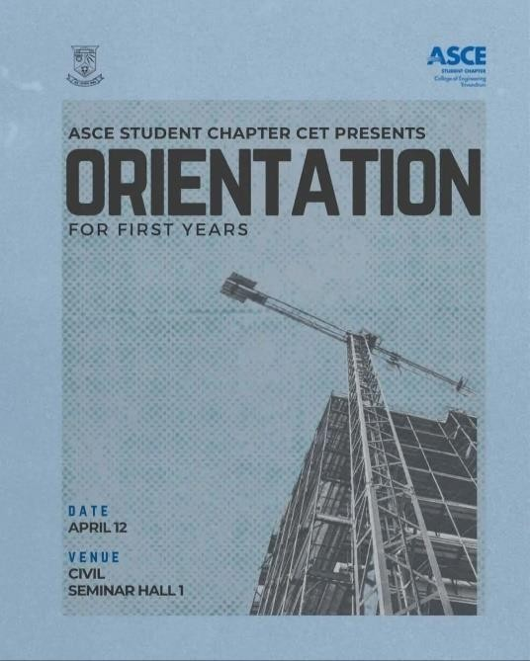
The club conducted following activities over the year 2023:
FIRST YEAR ORIENTATION
BATCH 2022-2026
DATE:12TH APRIL,2023
The ASCE CET chapter held an orientation with the aim of introducing students to the benefits and needs of ASCE. The orientation was attended by around 80- 120 students, making it a successful event.
The orientation started with a welcome speech from Abhiram S, the President of ASCE CET chapter. He welcomed the students and highlighted the importanceof ASCE in the civil engineering field. Following that, Dr. Anusha, advisor of ASCE CET addressed the students and gave an introduction to ASCE, highlighting its various benefits and needs. She emphasized the role of ASCE in providing networking opportunities, continuing education, and professional development
for civil engineers.

Slide 5
Diya Ann Joy (Program Head) shared last year’s ASCE CET Report, highlighting the achievements and activities of the organization. She talked about the various events, workshops, and seminars organized by ASCE CET and the impact they had on the civil engineering community she also encouraged the students
to participate in the upcoming events and take advantage of the opportunities provided by the organization Ascharya (Vice President) then detailed the registration procedure for students interested in becoming members of ASCE CET like the membership benefits, fees, and the process of joining the organization. She also clarified the doubts that students had regarding the registration process.
This orientation was a great opportunity for students to learn about the benefits of ASCE CET and how it can help them in their careers. The event was well- organized and informative, with the speakers providing valuable insights into the organization,
In conclusion, the ASCE CET chapter successfully conducted an orientation that introduced students to the benefits and needs of ASCE The event was well- attended and informative, and it provided a great platform for students to learn more about ASCE and its role in the civil engineering field.

Slide 6
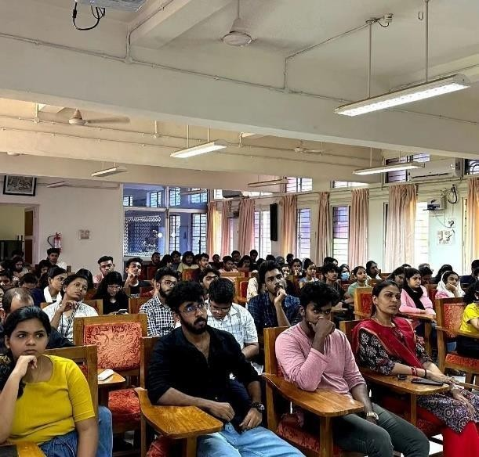
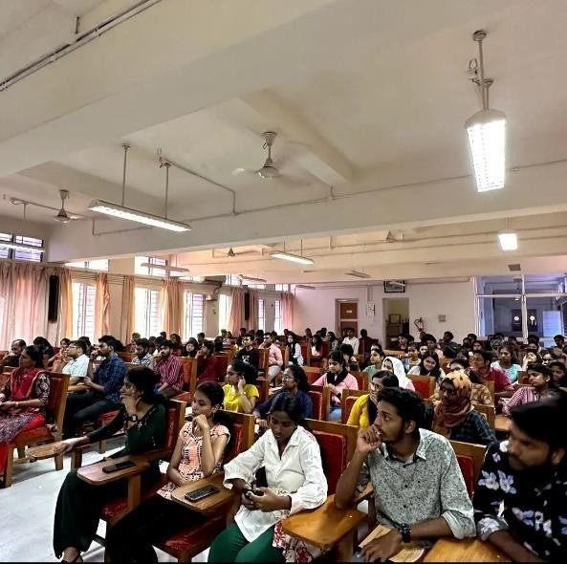
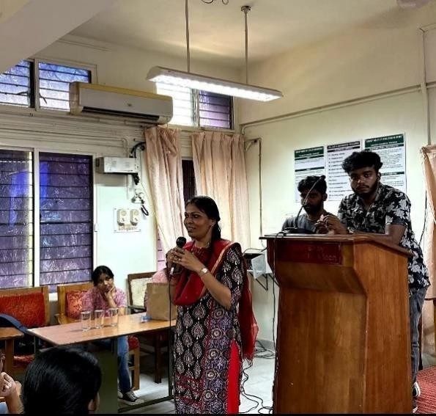

Slide 7
AUTOCAD WORKSHOP
DATE:26^{TH,}27TH,28THApril 2023
The ASCE Student chapter had held a 3-day workshop for AUTOCAD which was led by Abhiram S , the President of ASCE Student chapter and Chandu Krishna , the program coordinator , with the motive of upskilling the student with the features, traits, and use of AUTOCAD, a 3D design software which is an essential software in the field of civil engineering. The workshop was attended by over 60 students, marking it as fruitful. It was held on 26th, 27th and 28th of April 2023 , for an hour everyday from 4:30 to 5:30 pm

Slide 8
The event was predominantly attended by 1st year students of the civil engineering stream but was also engaged by few second year students. The registration for the event had started 2 weeks prior to the program. Cost of registration was 150 per head.
The event was made into 3 capsules each session covering every aspect of the software. On Day 1 the presenters gave an introduction to AutoCAD, including an overview of its interface and basic drawing commands. They also explained the importance of AutoCAD in the field of civil engineering and gave some examples of its applications.
On Day 2 the presenters focused on developing a plan of a house. Students were taught about basic tools like offset commands,layouts etc. The attendees were also taught how to use layout tabs to create multiple views of the drawing on a single sheet, which is a crucial skill for producing professional-quality drawings. On the final day, the presenters taught advanced commands, including floating, blocks, and other important tools and focussed on finishing of the plan developed.

Slide 9
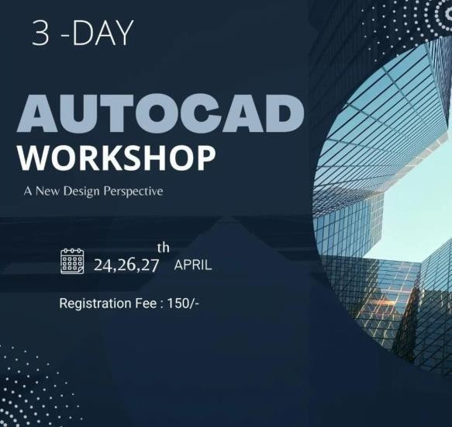
. The attendees were also taught how to use the block command to create reusable elements, which can save time and effort in creating drawings. The presenters gave some tips on how to use block attributes to add information to the drawing and create automated schedules.

Slide 10
APPRECIATION:
The AutoCAD workshop conducted by ASCE CET Chapter was well appreciated by the attendees as well as the academic staff. The ASCE CET Student Chapter advisor, Dr.Anusha S.P, and the Head of the Civil Engineering Department. Dr Anil R praised the program for its organization, content, and delivery. The attendees had a positive learning experience and were satisfied with the knowledge and skills gained from the workshop.
Conclusion: Overall, the AutoCAD workshop conducted by ASCE CET Chapter was remarkable. The attendees attained knowledge and were equipped with skills involving AutoCAD and its applications in civil engineering. The presenters, Abhiram and Chandu, were highly knowledgeable and delivered the content efficiently. The coordinators did a splendid job by organizing the offset commands, layouts, and advanced commands, such as floating and blocks and was particularly eminent in focussing on teaching comprehensive understanding of AutoCAD’s capabilities. We hope that such events will continue to be conducted by ASCE CET Chapter to help students enhance their technical knowledge

Slide 11
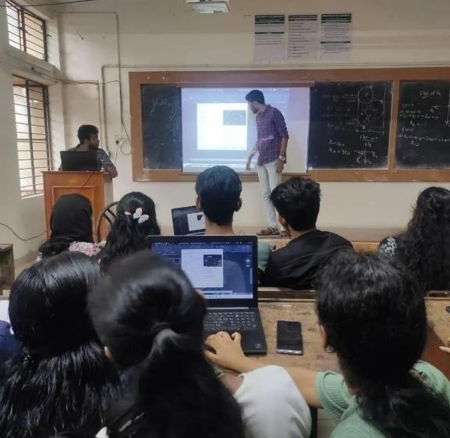
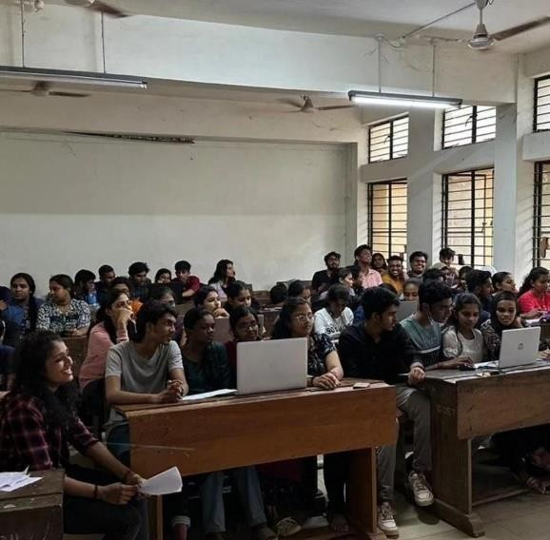

Slide 12
IDEATE IDEA PITCHING COMPETITION PRELIMS
Asce cet chapter conducted the prelims of an idea pitching competition -IDEATE, exclusively for civil engineering students.
Over 15 teams participated and 4 of them are selected to the finals which is set to be conducted by last of September. The competition aimed at bringing out innovative ideas that could be applied at department level and most of the ideas were really good.

Slide 13
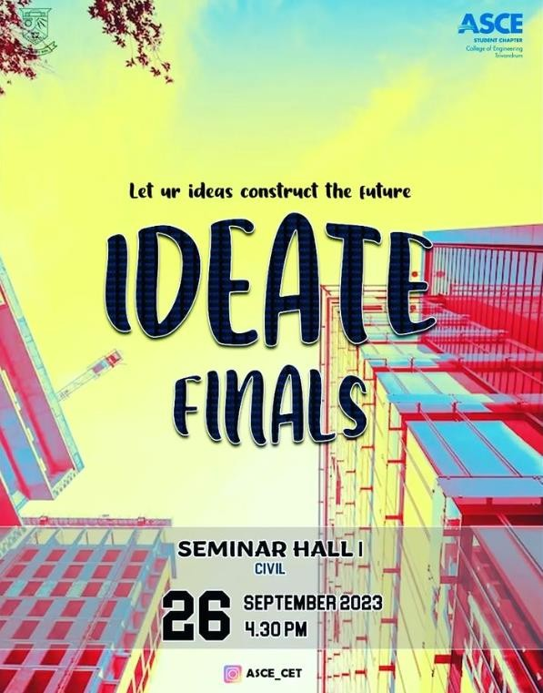
IDEATE IDEA PITCHING COMPETITION FINALS
The final round of idea pitching was conducted on September 26 2023 in the seminar hall Abhiram ASCE president heartily welcomed everyone to the competition. This competition was judged by Biju sir, Arun sir and Anusha miss experienced top faculties in the civil department CET. Three groups were shortlisted for the final round conducted earlier on the topic of renovating the surrounding of civil department. Shortlisted candidates underwent mentorship. sessions to refine their pitches, business models, and presentation skills. Three shortlisted groups presented their ideas effectively

Slide 14
Asce cet chapter conducted the prelims of an idea pitching competition -IDEATE, exclusively for civil engineering students.
Over 15 teams participated and 4 of them are selected to the finals which is set to be conducted by last of September. The competition aimed at bringing out innovative ideas that could be applied at department level and most of the ideas were really good.

Slide 15
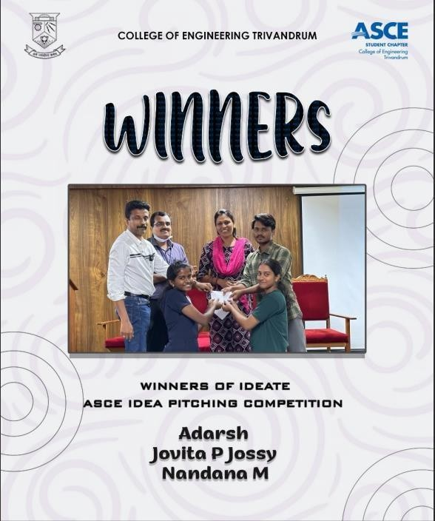
Asce cet chapter conducted the prelims of an idea pitching competition -IDEATE, exclusively for civil engineering students.
Over 15 teams participated and 4 of them are selected to the finals which is set to be conducted by last of September. The competition aimed at bringing out innovative ideas that could be applied at department level and most of the ideas were really good.
The second winning group passed in the preliminary stage and then they presented the topic parking problems, interlocking tiles withstand high traffic and weather conditions.

Slide 16
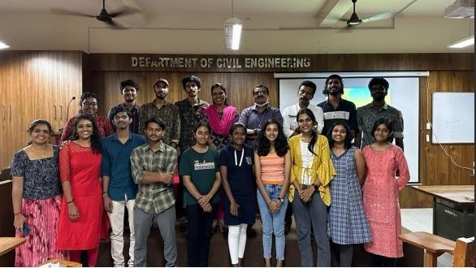
The third prize winners competed in the preliminary stage with the idea of sustainable development of the entire civil department by addressing about water harvesting system, parking issues,
solar lambs, waste management, planetarium renovation etc. In the final stage they proposed a plan of a new construction as a replacement for planetarium, which is a self sustainable
building that was cited as a cet memorium

Slide 17
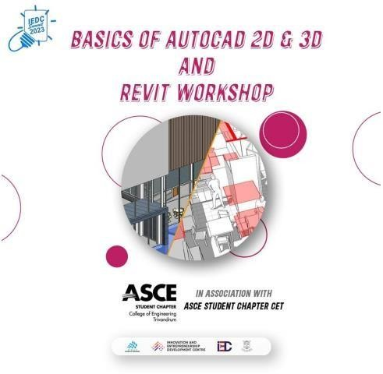
WORKSHOP ON BASICS OF AUTOCAD AND REVIT
DATE: 03 October 2023
TIME: 2.30 PM to 4.00 PM
Platform: Google Meet
The ASCE student chapter organized a workshop as part of the IEDC summit 2023, hosted at CET. The workshop, titled "Basics of AutoCAD 2D and 3D and Revit," aimed to foster design excellence among young minds. This online event took place on October 3, 2023. Abhiram S, the President of ASCE CET, and A Chandu Krishna, both certified Autodesk professionals, led the workshop. A total of 262 students participated via google meet, joining from the comfort of their own spaces with the necessary software at their disposal.

Slide 18
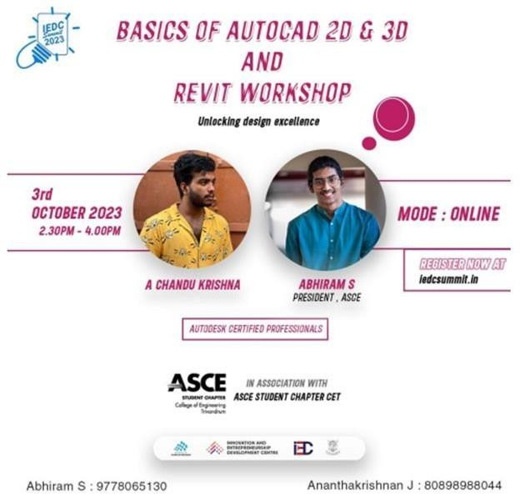
During the workshop, participants were instructed on the fundamentals of AutoCAD 2D and 3D, enabling them to create 2D plans for houses and buildings. Additionally, they learned the basics of Revit and received a demonstration of creating 3D house designs. This event provided a valuable opportunity for students to enhance their design skills and knowledge in these essential software tools
The workshop's impact resonates not only in the technical knowledge gained but also in the inspiration it provided to the next generation of designers and engineers. It was a testament to the ASCE's commitment to nurturing the talents of the future.

Slide 19
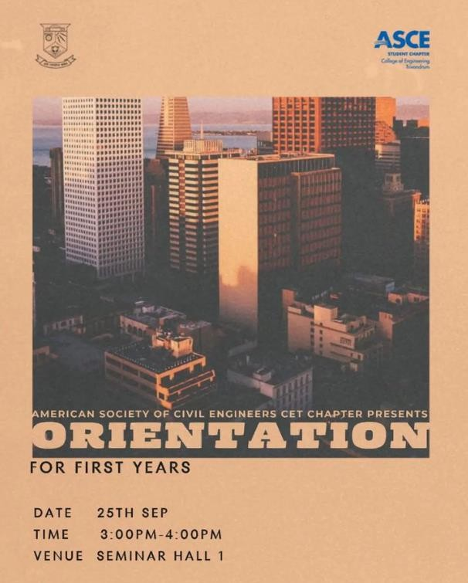
FIRST YEAR ORIENTATION BATCH 2023-2027
Date:25/09/2023
Time:3.00-4.00pm
Venue: Seminar Hall 1

Slide 20
The ASCE CET Chapter conducted the first-year orientation program with the objective of welcoming new students, providing information about the objectives, aspects and performance of ASCE chapter and establishing a sense of community within the chapter. Around 70-100 students attended the orientation, making it a successful event.
The orientation started with the welcome address by Abhiram S, President ASCE Student chapter. He presented an overview report of the initiatives and activities conducted by the committee so far. Following that Dr. Anusha, faculty advisor of ASCE CET addressed the students and emphasised on the importance of ASCE in academic and professional development of civil engineering students. She talked about the role of ASCE in providing networking opportunities and overall development in professional career.

Slide 21
Joe Thomas Cheriyan (Corresponding Secretary) briefed on the activities conducted last year. He talked about the events, workshops and webinars conducted by ASCE CET. Also shared the details of upcoming events and
encouraged the students to participate in the events and make use of the opportunities provided by ASCE.
Ascharya A (Vice President) detailed the registration procedure to join the organisation. She spoke about the importance of ASCE Membership, its benefits and registration fees. She also clarified the doubts regarding registration procedure.

Slide 22
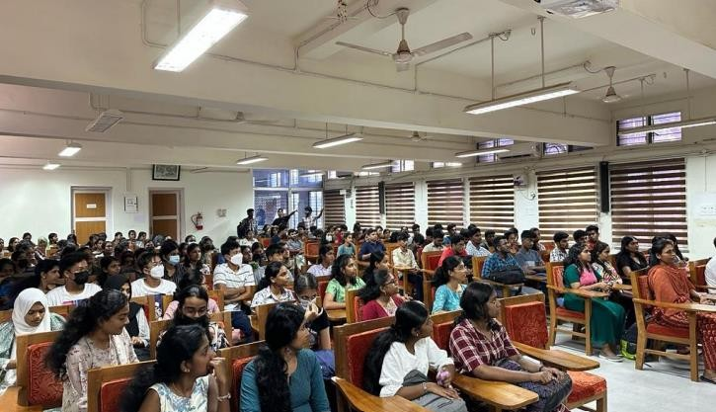
At the end of the event, an informal session talk session was arranged which provided an opportunity for new students to ask questions, clarify concerns and engage in open discussions with experienced members and advisors. This session provided a relaxed and inclusive atmosphere for addressing individual concerns and fostering a sense of community within the ASCE Chapter.

Slide 23
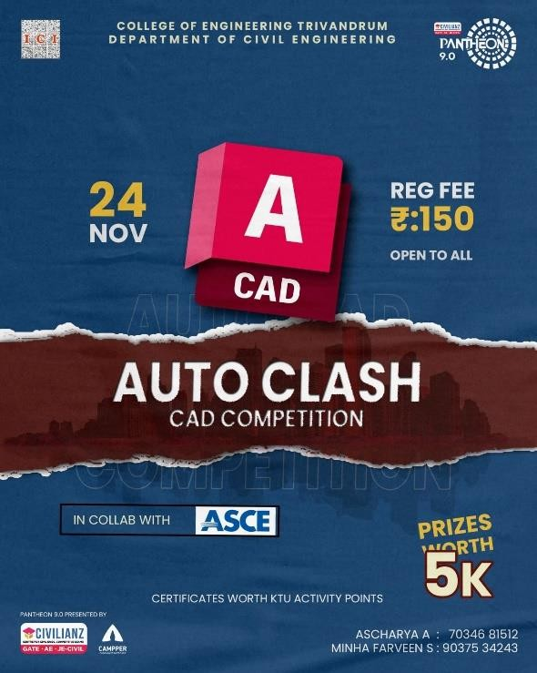
AUTOCLASH 2.0
Auto clash 2.0 is an event conducted in Pantheon 9.0 in collaboration with ASCE CET CHAPTER.
DATE: 24/11/2023
TIME: 9:00am to 05:00pm.
VENUE: ROOM NO 107 CE3 BLOCK CIVIL DEPARTMENT CET.

Slide 24
Auto clash 2.0 is a CAD competition conducted by ASCE CET. The competition was conducted in two sessions. The fore noon session included a presentation by the coordinators about the competition which described about the event, the problem statement, time allotted and potential judging criteria. The event had about 7 teams to compete (a total of 20 members). The teams where given particular locations in the campus such as Archie corner, Golden walkway, Sargam stage etc. And they were asked to make CAD drawings of the existing structures as well as to incorporate possible additions such as parking space, study area, open stages, rain water harvesting system etc. The teams were allotted with about 3hrs from 11:00am to 01:00 pm to visit the listed locations and to make necessary readings, rough sketches etc

Slide 25
This was followed by a lunch break for about an hour.
The competition resumed at 02:00pm. The teams were asked to make CAD drawings for the locations of their chose with practically possible innovative ideas within the next 3hrs.
Various judging criteria included were: sustainability, economy, possibility of the
new additions in the given area, design, AutoCAD proficiency, dimensioning, basic civil engineering knowledge, problem solving skills etc. The evaluation of CAD drawings were done by each team presenting their drawings in front of a panel of judges. The judging panel included 4 MTech scholars and Abhiram, President ASCE CET Chapter.

Slide 26
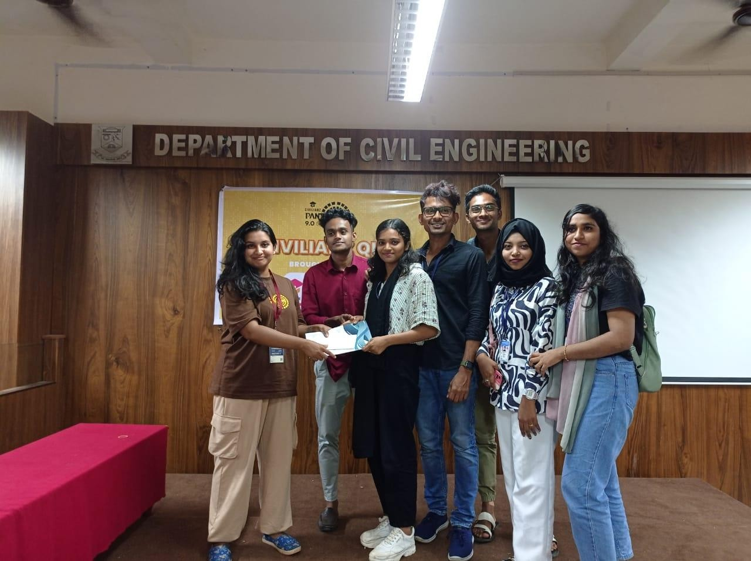
First prize was awarded to Kishor S E and team from MACE and second place was grabbed by Nikitha Nair S Sand team from CET. Winners was presented with prize worth 3k and the runners up were presented with a prize worth of 2k.
The event was a great success due to the participation of students with great CAD abilities and creative thinking

