Slide 1
Moment of Force about an axis
The effectiveness of a force as regards to its tendency to produce rotation of a body about an axis or a point is called moment of the force.
It is measured by the product of the magnitude of the force and arm of the force.
Arm of force, or moment arm is the perpendicular distance of the line of action of the force from the moment centre.
Moment centre is the point about which moment of a force is measured.

Slide 2
Moment of Force about an axis ...
The line perpendicular to the plane containing the force and passing through the moment centre is called axis of the moment.
Moment of force will be expressed in (Nm).
Vector qty
Depending upon the relative position of the force and moment centre, the moment of a force will be either clockwise or counter clockwise.
The sense of moment of a force is taken as clockwise when the force rotates or tends to rotate the arm of force in clockwise direction about the moment centre.

Slide 3
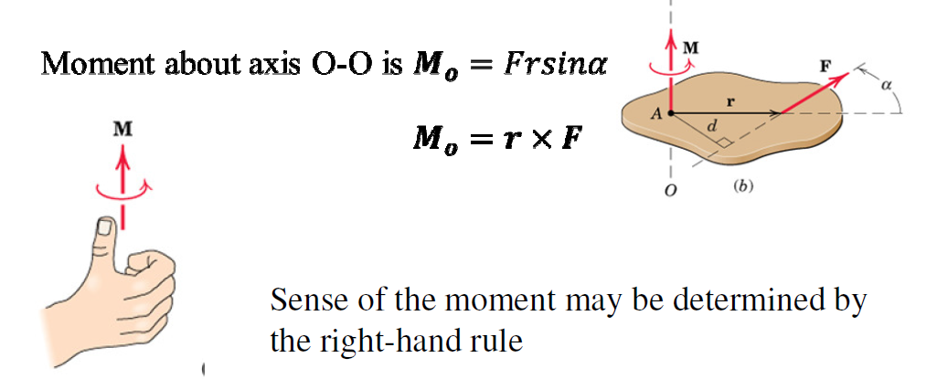

Slide 4
Moment of a force will be maximum when the line of action of the force is perpendicular to the line joining the moment centre and point of application of the force.
Moment of a force will be zero when,
(i) the force acts at the moment centre itself and
(ii) when the line of action of the force passes through the moment centre.

Slide 5
Varignon’s theorem of moments. - principle of moments
French mathematician Varignon (1654-1722)
states that the moment of a force about any axis is equal to the sum of moments of its components about that axis.

Slide 6
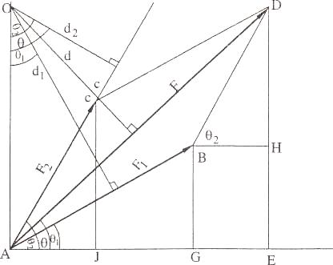

Slide 7
Consider a force F acting at a point A. F₁ and F₂ are the components of F along any two directions.
The moment of F about an axis through an arbitrary point O is F x d, where d is the arm of force F.
d₁ and d₂ are the arm of forces of F1 and F2, respectively.
Sum of moments of the components F1 and F2, about O ; F1. d1 + F2. d2
It is to be proved that F x d = F₁ x d₁, + F₂ x d₂.

Slide 8
AE = AG + GE ; = AG + BH ; = AG + BD cos θ₂
= AG + AC cos θ ₂
AD cos θ = AB cos θ₁ + AC cos θ ₂.
F cos θ = F ₁ cos θ ₁ + F₂ cos θ₂.
Multiplying by OA.
F x OA cos θ = F ₁ x OA cos θ ₁ + F₂ x OA cos θ₂
F x d = F₁ x d ₁ + F₂ x d₂
Moment of F about O = moment of F₁ about O + moment of F₂ about O.
Moment of given force about any point = Sum of moments of its components about the same point

Slide 9
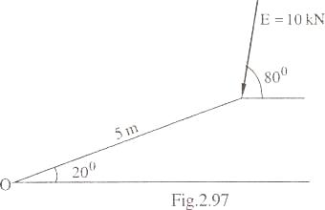
Calculate the moment of the given force F = 10 kN about point O

Slide 10
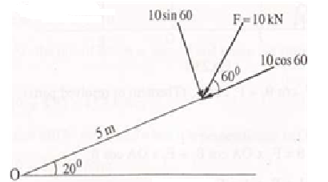
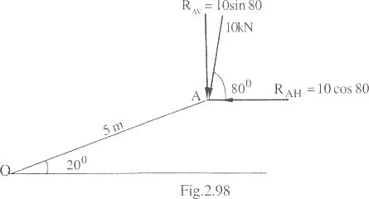
Resolving along and perpendicular to incline plane
M_{o} = (10 cos 60) x 0 + (10 sin 60) x 5 = 43.30 kNm.
Resolving vertical and horizontally
M_{o}= 10 sin 80 x5 cos 20- 10 cos 80 x 5 sin 20
= 43.30 kNm.

Slide 11
Coplanar non concurrent forces

Slide 12
Resultant of coplanar non concurrent forces.
Magnitude and direction of resultant of a number of coplanar concurrent forces, can be obtained by resolving the forces along two mutually perpendicular directions and then finding the resultant of the sum of components of the forces.
Resultant will be acting at the point of intersection of the concurrent forces.
Magnitude and direction of non concurrent forces can also be obtained by resolving the forces along two perpendicular directions.

Slide 13
Resultant of coplanar non concurrent forces…
To obtain the position of resultant force, equate the sum of moments off all the forces in the plane, about any point in the plane, with the moment of their resultant about the same point.
If the sum of moments of all the forces about a point is clockwise, then the position of resultant with respect to the point should be such that the moment of resultant about that point must also be clockwise.

Slide 14
Determine the resultant of the system of forces
10kN
10kN
20kN
20kN
4m
6m
7m

Slide 15
Since there is no horizontal or inclined force,
Σ Fh = 0;
Σ Fv = 0; -10+20 -20 -10 = -20 kN
Resultant R = [(Σ Fx)² + (Σ Fy)²]^{1/2}
R = 20 kN ; θ = 90
Inclination of resultant with positive X axis,
θ_{R}= 180 + θ = 270°
10kN
10kN
20kN
20kN
4m
6m
7m

Slide 16
Let the distance of line of action of this force from end A be x,
then Σ M _{A} = R. x
Σ M_{A} = 10 x 0 - 20 x 4 + 20 x 10 + 10 x 17
= - 80 + 140 + 170 = 290 kNm c.w.
Moment of R about A should be clockwise,
(for this R must be towards right of A)
Σ M_{a} = R . x
x = 230/20 = 14.5 m
R = 20 kN
x = 14.5m

Slide 17
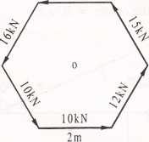
Six forces of magnitude 10 kN, 12 kN, 15 kN, 12 kN, 16 kN and 10 kN are acting along the sides of a regular hexagon of side 2 m in order.
Find the resultant force and its direction.
Find also the position of the resultant with respect to the centre of the hexagon.
12 kN

Slide 18
Σ Fh = 10 + 12 cos 60 -15cos 60 -12- 16cos60 + 10cos60 = - 6.5 kN
Σ Fv= 0+12 sin 60 + 15 sin 60 + 0 + 16 sin 60 -10 sin 60 = 0.866 kN
Resultant force R = 6.56 kN
θ = 7.59
Inclination of resultant θ_{R}=180-θ= 180 - 7.59= 172.41
Sum of moments of all the forces about the centre of hexagon,
Σ M = = - (10 + 12 + 15 + 12 + 16 + 10) x 2 sin 60
= - 75 x 2 sin 60 = 129.90 (ccw)

Slide 19
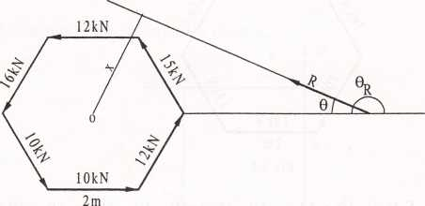
Let the distance of resultant force from the centre be x.
moment of resultant about the centre = R .x,
Equating these two moments,
R . x = 129 .90
X = 19.80 m

Slide 20
Parallel forces and couples.
forces whose lines of action are parallel to each other - parallel forces.
Like parallel and unlike parallel forces
Clockwise couple & anticlockwise couple
F1
F2

Slide 21
The resultant of two unlike parallel forces is zero. Hence these forces cannot be replaced by another single force.
Such two forces having the same magnitude, parallel line of action, and opposite sense are said to form a couple.
The plane in which the forces act is called the plane of the couple.
The distance between the line of action of forces is arm of couple.
moment of a couple = product of the magnitude of one of the forces and the arm of couple.

Slide 22
Properties of force couple
two forces constituting a couple are equal in magnitude and opposite in direction. Therefore, the sum of forces of a couple is zero.
the action of a couple on a rigid body will not be changed if its arm is turned in the plane of couple through any angle about one of its ends
without changing the action on a body; a given couple can be replaced by another one with different forces with a different arm, provided the moments of the two couples are equal.
Several couples in one plane can be replaced by a single couple acting in the same plane such that the moment of this single couple is equal to the algebraic sum of the moments of the given couples.

Slide 23
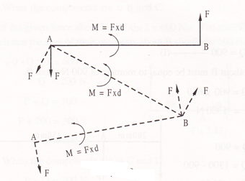
Properties of force couple…
F
Q
d
d1
F x d = Q x d1
F x d + Q d₁ = F x d + Q₁ x d
= (F +Q₁) d where Q₁ is Q1 x d = Q x d1
Q₁ = Q d₁ / d

Slide 24
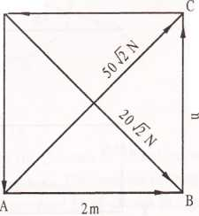
ABCD is a square whose side length is 2 m. Forces of magnitude 10,20,80 and 50 N act along AB, BC, CD and DA respectively. Forces of magnitude 50 2 N and 20 2 N act along the diagonal AC and DB respectively. Show that they are equivalent to a couple and calculate the moment of this couple.
80 N
2m
50 N

Slide 25
Resolving the forces horizontally,
ΣF_{h} = 10 - 80 + 50 2 x cos 45 + 20 2 x cos 45
= 0
lly ΣF_{v} = 0
Resultant R= 0
Taking moments of forces about A,
Σ M_{a} = (20 2 cos 45) x 2 - 80x2 -20x2
= 40 - 160 - 40
= - 160 N m = 160 N m c.c.w.
Since the resultant force is zero and the moment is not equal to zero, the system is equivalent to a couple of moment 160 Nm c.c.w.

Slide 26
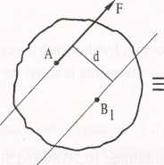
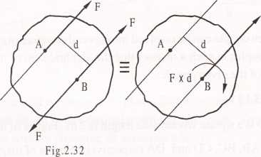
Resolution of a given force into force acting at a given point and a couple.
force F acting at A can be resolved into a force acting at B together with a couple of magnitude F x d

Slide 27
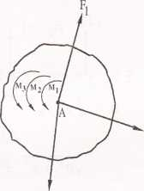
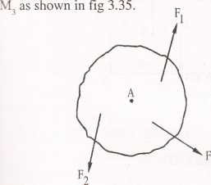
Reduction of system of coplanar forces acting on a rigid body into a single force and single couple

Slide 28
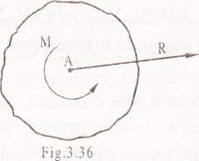
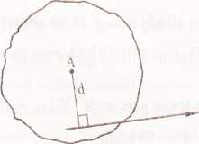
Reduction of system of coplanar forces acting on a rigid body into a single force and single couple…..

Slide 29
Replace the force acting at A 10 kN by a force and couple at
(i) B and
(ii) at C.
10 kN
4 m
3m
B
C
A

Slide 30
Moment at B = -10 * 3 = 30 kNm
When force acts at B, ΣFv = 10 and ΣMb =0
So a counter clockwise moment have to be applied at B 30kNm
10 kN
4 m
3m
B
C
B

Slide 31
Moment at C = 10 * 4 = 40 kNm
When force acts at C, ΣFv = 10 and ΣMC =0
So a clockwise moment have to be applied at C 40kNm
10 kN
4 m
3m
B
C
B

Slide 32
A rigid bar AB is acted upon by forces as shown in fig.
Reduce the force system to
(i) a single force
(ii) force moment system at A, and
(iii) force moment system at D.
6 kN
8 kN
4m
4m
3m
12 kN
8 kN

Slide 33
ΣFv = 6 kN
R = 6 kN
Case-1
Let resultant be at a distance of x from A
ΣMa = 6 x 4 + 8 x 8 -12 x 11 = -44 kNm ccw
Moment of resultant about A = 6 . x
6x = 44
x = 7.33 m
R = 6 kN
x = 7.33 m

Slide 34
Case -2 – force moment system at A
Ma = 44 kNm ccw; resultant is 6 kN upwards
Case -3 – force moment system at D
Md = 4 kNm cw; resultant is 6 kN upwards

Slide 35
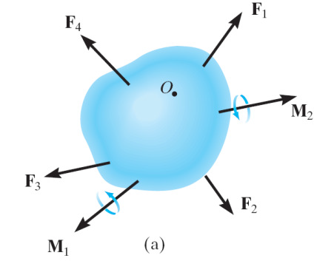
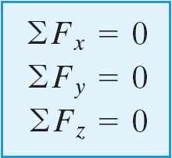
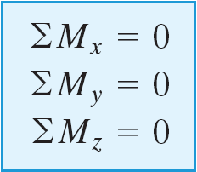
Rigid Body Equilibrium
A rigid body will remain in equilibrium provided
Sum of all the external forces acting on the body is equal to zero, and
Sum of the moments of the external forces about a point is equal to zero

