Slide 1
GPS SURVEYING METHODS

Slide 2
GPS SURVEYS
Static surveying
Rapid static surveying
Reoccupation mode
Kinematic surveying
Real – time DGPS surveying

Slide 3
STATIC SURVEYING
First method and primary technique
Involves long observation time (1-2 hrs depending on number of visible satellites) in order to resolve the integer ambiguities between the satellite and the receiver
Atleast two receivers collect carrier-phase data in stationary or static mode for a long duration of time

Slide 4
STATIC SURVEYING (Contd..)
Line between a pair of GPS receivers is called baseline
Station coordinate differences are calculated in terms of 3D coordinate system (X, Y, Z) based on WGS84 ellipsoid (standard coordinate system for the Earth)
These coordinate systems are then shifted to projected coordinate
One of the receivers is placed on point whose coordinates are known (reference receiver)
Second one is positioned over the point whose coordinate is unknown (rover)

Slide 5
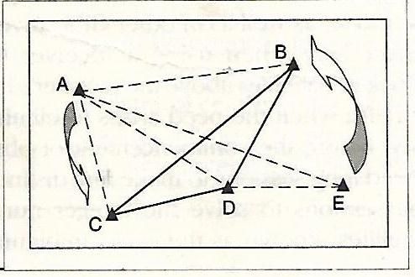
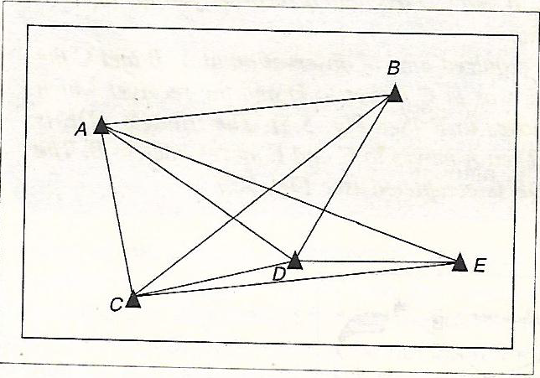

Slide 6
STATIC SURVEYING (Contd..)
Both receivers must receive signals from the same four or more satellites for a period of time (few minutes to several hours)
Session’s duration depends on:
length of baseline
geometry of satellites
Precision of result required
Larger the constellation of satellites, lower the session duration

Slide 7
STATIC SURVEYING (Contd..)
Post processing software analyzes all data from the receivers simultaneously and obtains the differential position between the receivers
Used for long lines, geodetic networks, tectonic plate studies
Offers high accuracy of 1cm to 0.1cm over long distances like 10km

Slide 8
APPLICATIONS OF STATIC METHOD
Geodetic control over large areas
National and conventional networks
Monitoring tectonic movements
High accuracy survey networks

Slide 9
RAPID STATIC SURVEYING
To measure baselines and determine positions up to centimeter level with short observation time of about 5-20 min
A reference point is chosen and one or more rovers operate with respect to it
Used for detailing the existing network, establishing control points etc..
Reference receiver is set up at a known point
Rover receivers are moved to each of the required points

Slide 10
RAPID STATIC SURVEYING (Contd..)
When working with more than one rover, it is essential to ensure that all rovers operate at each occupied point simultaneously
Rapid static technique provide the same accuracy available from 1-2 hr session of static positioning with observations of 5-20 min
Reoccupation
Reoccupation surveys are similar to Rapid-Static, except that the length of each session is short.
Each point is re-visited after at least an hour, when the geometry of the satellites becomes significantly different

Slide 11
STOP-AND-GO TECHNIQUE IN KINEMATIC METHOD
Referred as semi-kinematic surveying, in which the carrier phase ambiguities are resolved before the actual survey starts
A reference station is established
At least four satellites have to be tracked without loss of signal
The roving receiver starts from the known position coordinates
Then it moves to other points maintaining lock on the satellites
Rover maintains only for a small time for two epochs on each detail point
Epoch is a particular fixed instant of time used as a reference point on a time scale

Slide 12
STOP-AND-GO TECHNIQUE (Contd.)
Similar to rapid static method in which,
All receivers observe the same satellites simultaneously
Reference receiver occupy the same control point throughout the survey
Kinematic method differs in the movement of rovers from point to point
Stop momentarily at each new point for a short period
Data provides vectors between themselves and reference receivers

Slide 13
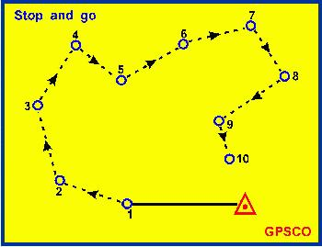
STOP-AND-GO TECHNIQUE (Contd.)

Slide 14
APPLICATIONS
Used for detailed and engineering surveys in open areas
Used where points are close together

Slide 15
ADVANTAGES AND DISADVANTAGES
Advantages
Fast and economical
Fastest way to survey detail points
Disadvantages
New static or rapid static fix is needed if complete loss of satellite lock occurs
Must maintain phase lock of at least four satellites for a successful survey

Slide 16
TRUE KINEMATIC METHOD
Uses differential carrier phase tracking
Requires two receivers for recording observations simultaneously
Referred as dynamic surveying
Reference receiver remains fixed on a known control point
Roving receiver collects data on a moving platform (vehicle, vessel, aircraft etc.)

Slide 17
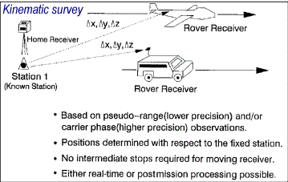
TRUE KINEMATIC METHOD

Slide 18
TRUE KINEMATIC METHOD (Contd.)
The reference and rover are switched on and remain stationary for 5-20 min for collecting data
After this period, the rover may move freely
While the rover moves, the user can record its positions at a predefined recording rate (say 1, 2, 3,4,5 seconds)
If loss of satellite lock occurs, a new period of static initialization must take place

Slide 19
TRUE KINEMATIC METHOD (Contd.)
Advantages
Very short sessions
Fast and economical
Produce largest number of positions in least time
Continuous measurements
Disadvantages
Slight degradation in the accuracy of work
Needs initialization in the case of complete loss of satellite lock
Occupied stations should be free of overhead obstructions
Route between stations must be clear

Slide 20
TRUE KINEMATIC METHOD (Contd.)
Applications
Measuring trajectory of moving objects
In hydrographic surveys
In surveying centre of road
Photogrammetry with ground control
For preparation of topographic maps

Slide 21
REAL TIME DIFFERENTIAL GPS (DGPS)
Improves accuracy
Reference receiver computes the error and transmits to the rover
Radio data link between reference and rover
Rover applies correction
No post processing required

Slide 22
PLANNING OF GPS SURVEYING
Fundamentally carried out in four phases
Planning and preparation
Field operations
Post processing and data generation
Report preparation

Slide 23
PLANNING AND PREPARATION
Selection of station points
Points to be positioned and their accuracy requirement should be identified
Site to be positioned and control points available should be plotted
Serves as a reference throughout the planning, project execution and final reporting stage

Slide 24
Field reconnaissance
It gives information like
Set of point required for GPS observations
Current description of the site
Access information
Description of any special steps which need to be taken

Slide 25
Field reconnaissance(contd..)
Site should be checked for suitability for GPS survey, availability of control points
Site should be free from obstructions and interferences
Obstructions may be avoided by establishment of eccentric stations
Site should be free from obstruction in all direction above 15˚ elevation
Interference to GPS signal due to electrical and multipath interference should also be considered

Slide 26
Monumentation
Points/Stations are required to be marked properly
Standard specification to be followed
Objectives to find the points easily and station may be placed properly

Slide 27
Selection of Observation window
To determine optimum daily observation period and to decide how to subdivide
Factors considered
Visibility – by observing azimuth elevation chart
Geometry of satellites- by comparing GDOP values
Ionospheric refraction

Slide 28
Selection of observation session
Depends on
Length of baseline
Number of visible satellites
Relative geometry of satellites
Signal to Noise Ratio of received satellite signal

Slide 29
Selection of positioning technique
By considering aspects like
Accuracy requirement
Geographical environment
Distance between points to be positioned
Cost

Slide 30
Selection of receiver type
Receivers should be of same make for relative positioning
Technical considerations for receiver selection are
Methods of collection of L2 carrier
Number of channels
Measurement accuracies

Slide 31
Survey design
It includes control requirements, network configuration and redundancy
Survey design will vary greatly depending on the accuracy sought and the GPS positioning technique employed

Slide 32
Preparation
To determine and decide the best window to be used to collect GPS data
To decide the optimal number of GPS receivers and personnel for the project and make the necessary arrangements
To plot the survey design, taking into account control requirements, network configuration, travel time between sites, satellite window and logistical constraints

Slide 33
Preparation(Contd..)
To arrange transportation between sites
To establish unique numbering system to clearly identify all sites positioned on the ground with their related computer data files and other associated attribute
To train personnels
To organize accommodation for field
To organize all requirements and supplies to support GPS field activities

Slide 34
Validation of plan for execution
The procedure and equipment to be used, from data collection to final product should be checked to ensure they are reliably satisfy the desired accuracy requirements
Positioning method chosen, equipment used and processing method adopted are checked

Slide 35
(B) FIELD OPERATION
Responsibilities in field are divided among a part chief, observer and a processor
These responsibility may be assigned to one person or shared amongst many

Slide 36
Party chief responsibility
To ensure all crew members have the training and information required to carry out observations according to plan
Daily duties includes
Scheduling who should observe at what station
Keeping informed of any satellite problem/ geometric storms
Accessing results on daily basis and modifying plans as required
Handling any logistical difficulties

Slide 37
Observers responsibility
Observer should know where when and for how long GPS observation should be collected
Field responsibility can be broken down into four stages
Preparation for observations
Set up in field
Monitoring receiver station
Terminating observations

Slide 38
Observers responsibility(Contd..)
A comprehensive field log for each site should be maintained by observer
The following in formations should be documented
Site name and identifier for receiver data file
Observer’s name
Receiver and antenna types and serial number
Data collection start and stop time
Satellites tracked
Problems experienced and actions taken

Slide 39
Processor’s responsibility
Data submitted should be verified to ensure they are clear, complete and accurate
Data should be downloaded to computer
Processing should be carried out to judge if the collected data is of adequate quality
Analyze processing results to access the goodness of the data and pass results to party chief
Notes on data processed, difficulties experienced and action taken to be kept

Slide 40
DATA SHEET
Sample of Data Sheet

Slide 41
VISIBILITY DIAGRAM
Obstruction above 15˚ angle around station is noted in visibility diagram
Visibility Diagram

Slide 42
(C) POST PROCESSING & DATA GENERATION
Observed data needs to be transferred, processed and tested for quality
As per requirement the observed data is processed further to carry datum transformation, computation of coordinates

Slide 43
(D)REPORT PREPARATION
A project report must address the
following topics:
Location and description of project area
Purpose of survey and achievements in comparison to standard specifications
Description of monumentation
Instruments used and their detail specification

Slide 44
5. Computation scheme for the project and processing software
6. Datum transformation parameters and their source, computation of coordinates and sketch of control points
7. Problems encountered during survey work

Slide 45
8. Following list must be included
List of loop closures
Occupation schedule
Vector statistics
List of adjusted positions and plane coordinates
Project statistics
Copies of original site occupation log
Equipments malfunctioning log
Project sketch showing all points and control points
9. Copy of original observation should be transmitted

Slide 47
INTEGER AMBIGUITY (INITIAL AMBIGUITY)

