Slide 1
MODULE III

Slide 2
GEOMATICS
Geomatics, also known as geospatial science is the discipline of gathering, storing, processing, and delivering geographic information or spatially referenced information.
"Geo" refers to the land and "matics" refers to the mathematics and science used to study the land
Utilize advanced tools such as
Total stations,
Global Positioning System (GPS),
Digital aerial imagery
Geographic Information Systems (GIS)
Enable to gather, process, analyze, visualize and manage spatially related information to solve a wide range of technical and societal problems.

Slide 3
GLOBAL POSITIONING SYSTEM (GPS)

Slide 4
GLOBAL NAVIGATION SATELITE SYSTEM(GNSS)
Satellite navigation System - uses satellites to provide geo-spatial positioning
Satellite navigation system with global coverage may be termed a global navigation satellite system (GNSS)
Allows small electronic receivers to determine their location… (longitude, latitude, and altitude/elevation)

Slide 5
Various global navigation systems
NAVSTAR GPS by USA
GLONASS by Russia
Galileo by European Union
IRNSS (Indian Regional Navigation Satellite System, NavIC)
GAGAN (GPS Aided Geo Augmented Navigation)

Slide 6
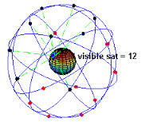
GLOBAL POSITIONING SYSTEM (GPS)
Satellite-based radio navigation system
High precise positioning system
Developed by US dept of Defence
Shortened form of NAVSTAR GPS
NAVigation System with Time And Ranging Global Positioning System
Uses constellation of 24 operational satellites, to give user an accurate position on earth

Slide 7
GLOBAL POSITIONING SYSTEM (GPS) (Contd.)
Originally designed for military purpose
Later used for marine navigation and surveying
Finding positional values accurately at any point on earth’s surface, at any time and in all weather conditions

Slide 8
SYSTEM OVERVIEW OF GPS
Space segment
Satellites orbiting the earth
Control segment
Control stations positioned at various locations to control the satellites
User segment – GPS users
Anybody who receives and uses the GPS signal comes under this segment

Slide 9
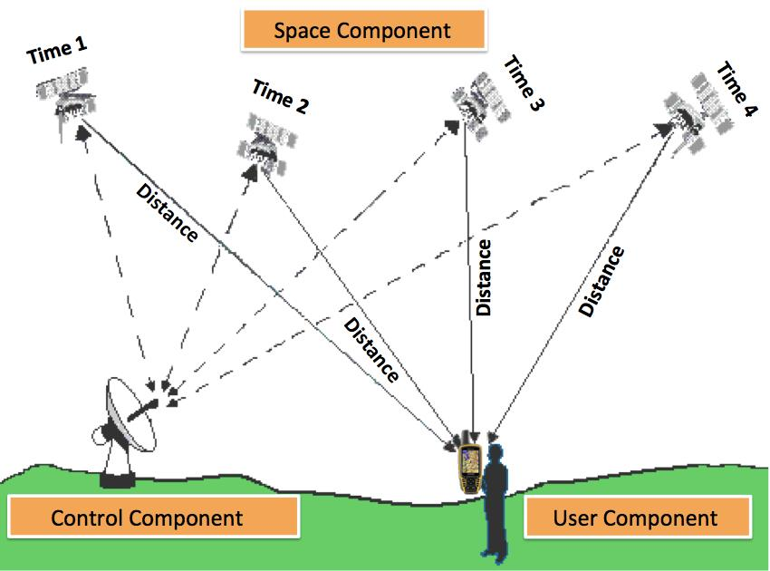
SYSTEM OVERVIEW OF GPS (Contd..)

Slide 10
THE SPACE SEGMENT
Constellation of GPS satellites and the signals broadcast by them
Allows users to determine position, velocity and time
24 satellites at an altitude of 20,200 km orbiting the earth every 12 hours
Travelling at speeds of 11,500 km per hour
Powered by solar energy (back up batteries are also there)
Satellites in six orbital planes

Slide 11
FUNCTIONS OF SATELLITES
The functions of satellites are:
To receive and store data transmitted by the ground control stations
To maintain accurate time by means of several on-board atomic clocks
To transmit information and radio signals to users

Slide 12
CONTROL SEGMENT
Consists of:
One master control station
Four monitoring stations
Four ground antennas
Master station in Colorado Springs, Colorado (USA)
Four monitoring stations at Cape Canaveral, Ascension Island, Diego Garcia and Kwajalein Atoll

Slide 13
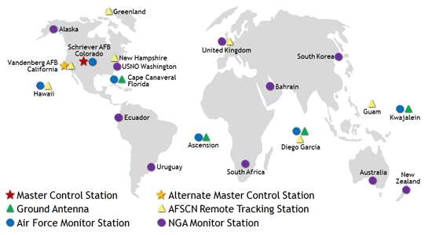
CONTROL SEGMENT (Contd..)

Slide 14
CONTROL SEGMENT (Contd..)
Tracks GPS satellites, update their orbiting position and calibrates and synchronizes their clocks
To determine the orbit of each satellite and predict its path for the next 24 hours
There may be possibility of satellites travelling out of orbits
Ground monitor stations keep track of satellite orbits, altitude, location and speed
Ground stations send the orbital data to master control stations, which send corrected data to the satellites through ground antennas
Corrected and exact position of data is called “Ephemeris”

Slide 15
THE USER SEGMENT
Comprises GPS receivers used to receive the GPS signal for determination of position and time
The typical receiver is composed of an antenna and preamplifier, radio signal microprocessor, control and display device, data recording unit, and power supply.
GPS receivers convert signals into position, velocity, and time estimates. A minimum of four satellites are required to compute the four dimensions of X, Y, Z (position) and Time.
Typical applications within the user segment are land navigation, marine navigation, surveying and aerial navigation

Slide 16
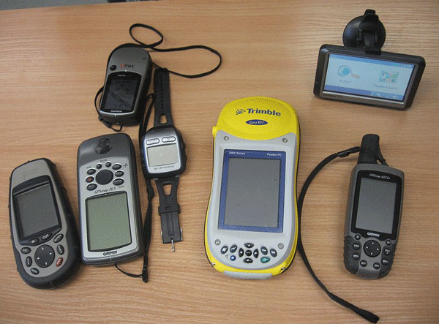
THE USER SEGMENT

Slide 17
WORKING OF GPS
All the 24 satellites are constantly revolving around the earth in a very definite orbit
The satellites from their orbits transmit information to earth
The GPS receiver on the Earth receives this signal and with the help of triangulation of signals from other satellites, it can determine the geographic location.
It does this using accurate time measurements.
The clock that the satellites maintain are very accurate atomic clocks
GPS receiver correlates the time between which a signal was broadcasted by the satellite with the time it was received.
This difference in time tells the GPS receiver about one aspect of your location, and by connecting with some more of the 24 revolving satellites around Earth you can accurately obtain your latitude, longitude, altitude, speed and bearing.

Slide 18
ADVANTAGES
Relatively high positioning accuracies, in mm level
Capability of determining velocity and time
Signal availability to users, anywhere on the globe
Positioning system with no user charges and uses relatively low cost hardware
All weather system, available 24hrs a day
Position information is in 3 dimensions

Slide 19
FEATURES OF GPS
A one-way ranging system, in which the satellites transmits signals, but are unaware of who is using the signal. Hence the user cannot be
Detected by enemy (military context)
Charged for using the system (civilian context)
Use of latest atomic clock and microwave transmission technology, including spread-spectrum techniques
Satellite signals are unaffected by cloud and rain

Slide 20
FEATURES OF GPS (Contd..)
Multiple satellite system, which ensures the visibility of sufficient number of satellites anywhere on the globe, at any time
not less than four satellites at any time, at any point on the surface of earth

Slide 21
SIGNAL
The transmitter power of a Global Positioning System satellite is a 50 watts.
The satellite transmits two carrier waves (radio waves), L1 and L2, derived from the fundamental frequency of 10.23 MHz, generated by atomic clock
L1 carrier is broadcast at 1575.42 MHz (10.23X154)
L2 carrier is broadcast at 1227.60 MHz (10.23X120)

Slide 22
SIGNAL (Contd….)
L1 carrier has two codes modulated upon it
Coarse/Acquisition code (C/A Code) – 1.023MHz
Precision code (P-Code) – 10.23 MHz
L2 carrier has one code modulated upon it
Precision code (P-Code) – 10.23 MHz

Slide 23
SIGNAL (Contd….)
The signals can penetrate through plants, clouds, glass but will not go through solid structures and mountains
Each signal consists of three different bits of information – a pseudorandom code, ephemeris data and almanac data.
The pseudorandom code is simply an I.D code which identifies which one of the 24 GPS Satellites this signal is coming from.
Ephemeris data is the heart of the signal. This part of the information is essential for determining position. It contains data about the status of the satellite, current date and time
The almanac data instructs the GPS Receiver about the orbital information of all the 24 satellites; basically this tells the Global Positioning System where all the satellites are and will be.

Slide 24
GPS CODES
GPS codes are binary, strings of zeros and ones, the language of computers
Coarse/Acquisition code (C/A Code) – 1.023MHz
Precision code (P-Code) – 10.23 MHz
Transmitted code is called pseudo-random code
Since it looks like a noise signal
Complex code
Each satellite has its own unique pseudo-random code

Slide 25
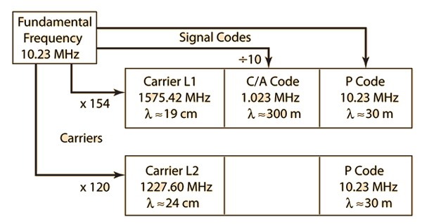
GPS SATELLITE SIGNAL STRUCTURE

Slide 26
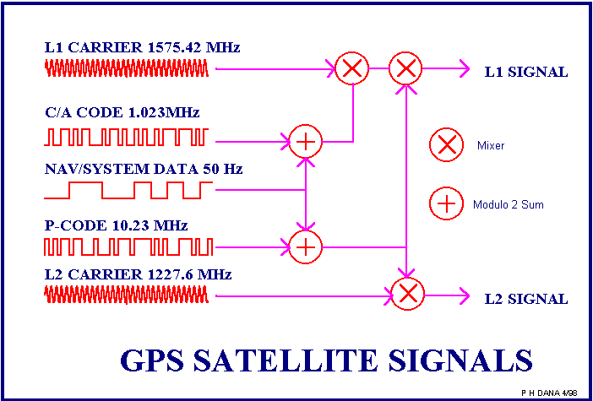
GPS SATELLITE SIGNAL STRUCTURE (Contd..)

Slide 27
SATELLITE RANGING
Satellite range – distance from the satellite to the GPS receiver
GPS positions are based on the distance from the satellite to the GPS receiver on earth
Basic idea of determination of position is
resection or trilateration
Distance = velocity X time
Velocity of radio signal = 290,000 km per s (almost equal to speed of light)
Precise time - when signal left the satellite and when it reach the receiver

Slide 28
SATELLITE RANGING - TIME CALCULATION
Main purpose of coded signal is:
calculation of travel time of radio signal from satellite to GPS receiver
Also called Time of Arrival
When pseudo-random code reaches GPS receiver, it generates the same code and tries to match with the satellite’s code
Receiver compares two codes to determine how much delay is required in its code to match the satellite code

Slide 29
SATELLITE RANGING - POSITION CALCULATION
Four unknowns to be determined
Position coordinates (x,y,z)
Time of travel of signal
Observation of four satellites produces four equations
When receiver picks up a signal from one satellite, the position will be an imaginary sphere with satellite as centre and distance as radius
GPS receiver starts picking up signals from two satellites

Slide 30
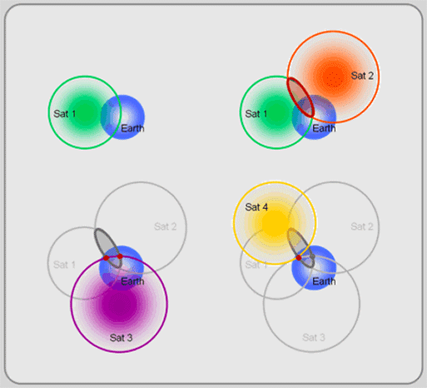
SATELLITE RANGING - POSITION CALCULATION (Contd..)

Slide 31
SATELLITE RANGING - POSITION CALCULATION (Contd..)
Position of GPS receiver will be along the intersection of two large circles
When receiver picks up signals from third satellite, the position of receiver will be on the point of intersection of three circles
With four satellites, the receiver will get a precise position and it will be able to compute the elevation of position with reference to a selected datum

Slide 32
GPS MEASUREMENT TECHNIQUES
2 types of signal measurement approaches have been used for positioning with GPS
Important observables are code and phase values methods based on these two are used
Code measurements
Carrier phase measurements

Slide 33
CARRIER PHASE MEASUREMNT
Processing technique that gathers data via a carrier phase receiver, which uses the radio signal (carrier signal) to calculate positions. The carrier signal, which has a much higher frequency than the pseudo-random code, is more accurate than using the pseudo-random code alone.
GPS receivers which record carrier phase, measure the fraction of one wavelength (i.e. fraction of 19 cm for the L1 carrier) when the receiver first locks onto a satellite and continuously measure the carrier phase from that time
Number of cycles between the satellite and receiver at initial start up (known as the ambiguity ) and the measured carrier phase together represent the satellite-receiver range

Slide 34
CODE PHASE MEASUREMENT
Processing technique that gathers data via a C/A (coarse acquisition) code receiver, which uses the information contained in the satellite signals (the pseudo-random code) to calculate positions.
A GPS receiver determines the travel time of a signal from a satellite by comparing the "pseudo random code" it's generating, with an identical code in the signal from the satellite
The receiver "slides" its code later and later in time until it syncs up with the satellite's code
Amount it has to slide the code is equal to the signal's travel time
Code measurements are the difference in time between when the code is transmitted from a satellite and received at a GPS receiver, multiplied by the speed of light

Slide 35
Carrier phase vs code phase
The carrier phase receivers are much more accurate than C/A code receivers
Carrier phase receivers require a clear view to the satellites in order to maintain a constant lock with at least 4 satellites, while C/A code receivers do not need to maintain a constant lock with the satellites to calculate positions. This makes a C/A code receiver imperative to gathering data in adverse conditions
Code phase processing- GPS measurements based on the pseudo random code (C/A or P) as opposed to the carrier of that code. (1-5 meter accuracy)
Carrier phase processing- GPS measurements based on the L1 or L2 carrier signal. (sub-meter accuracy)

Slide 36
GPS ERRORS
Ephemeris errors
Clock stability
Ionospheric delays
Tropospheric delays
Multi-path
Dilution of Precision
Satellite and receiver clock errors
Antispoofing
Receiver noise

Slide 37
1. EPHEMERIS ERRORS
Errors in the prediction of a satellite position
Satellite dependent
Very difficult to correct

Slide 38
2. CLOCK STABILITY
GPS satellites carry rubidium and cesium time standards
Receivers are accurate by Quartz standard accuracy
Time offset – difference between time recorded by satellite clock and that recorded by receiver
R_{E} = T₀ X c
where, R_{E} = User Equivalent Range Error (UERE)
T₀ = time offset
c= speed of light

Slide 39
3. IONOSPHERIC DELAYS
Non-linearly dispersed and refracted when transmitted through a highly charged environment like ionosphere
Results in an error in the GPS range value
Ionospheric range effect – dispersion and refraction of GPS signal
Signal is slowed down since the medium is denser
Factors that influence the amount of delay
Satellite elevation and geometry
Density of ionosphere

Slide 40
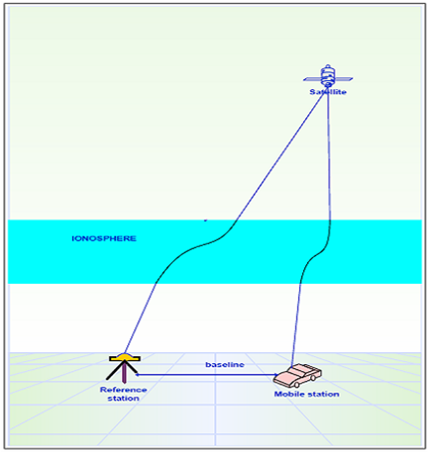

Slide 41
4. TROPOSPHERIC DELAYS
GPS signals are refracted while in troposphere
Density of troposphere governs the severity of its effect

Slide 42
5. SIGNAL MULTIPATH
Occurs when the signal arrives at the receiver from more than one path
Occurs when the GPS receiver is positioned close to a large reflecting surface such as big rock or a building
Signal hits the object and is reflected to receiver creating a false measurement
Increase the travel time of signal

Slide 43
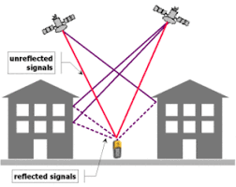

Slide 44
6. GEOMETRIC DILUTION OF PRECISION (GDOP)
Measure of strength of satellite geometry
Wider the angle between satellites, the better the measurement
A low DOP indicates a higher accuracy, and a high DOP indicates a lower accuracy.
Low value is good (less than 8)
Best to observe satellite 15˚ above the horizon

Slide 45
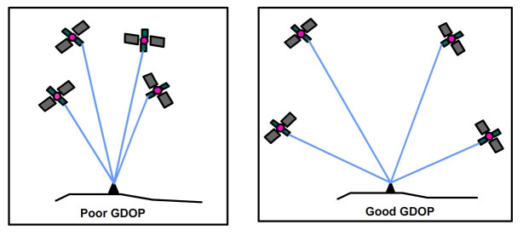
GDOP

Slide 46
7. SATELLITE AND RECEIVER CLOCK ERRORS
Satellite clocks are very accurate to about 3 nanoseconds
Sometimes drift slightly and cause small errors
US department of Defence monitors the satellite clocks using the control segment and corrects the drift

Slide 47
8. ANTI-SPOOFING (A/S)
Intended to deny the P-code part of GPS signal
Forcing the user to use C/A code, which has A/S applied
Encrypts the P-code into a signal called the Y-code
Only users with military GPS receivers can decrypt the Y-code

Slide 48
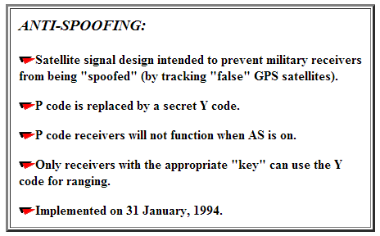

Slide 49
9. RECEIVER NOISE
Includes a variety of errors associated with the ability of the GPS receiver to measure a finite time difference
Include signal processing, clock/signal synchronization and correlation methods, receiver resolution, signal to noise ratio etc

Slide 50
APPLICATION OF GPS
Used for navigation by mariners and fishermen
Survey operations
Emergency road side assistance at the push of a button
Vehicle tracking
Route guidance

