Slide 1
BASICS OF REMOTE SENSING

Slide 2
What is remote sensing?
"Remote sensing is the science (and to some extent, art) of acquiring information about the Earth's surface without actually being in contact with it. This is done by sensing and recording reflected or emitted energy and processing, analyzing, and applying that information."

Slide 3

REMOTE SENSING
Remote Sensing refers to gathering and processing of information about earth’s environment and its Natural & Cultural Resources through Aerial photography and Satellite scanning.

Slide 4
ADVANTAGES OF REMOTE SENSING
Better & Faster
Large Area Coverage
Synoptic & Repetitive Global Coverage
Data Acquisition
- over Inaccessible Area
- at Multiple Heights
Multidisciplinary Utility
Digital Data Compatibility
Economical & Efficient Technology

Slide 5
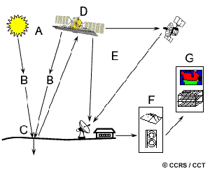
Components of remote sensing
Energy Source or Illumination (A)
Radiation and the Atmosphere (B)
Interaction with the Target (C)
Recording of Energy by the Sensor (D)
Transmission, Reception, and Processing (E)
Interpretation and Analysis (F)
Application (G)

Slide 6
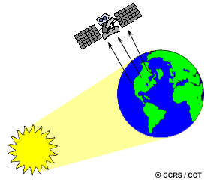
Passive remote sensing
Remote sensing systems which measure energy that is naturally available
Uses sun as the source of EM energy

Slide 7
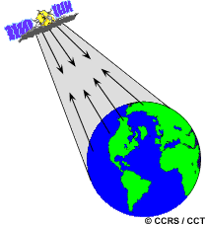
Active remote sensing
Active sensors provide their own energy source for illumination.

Slide 8
PLATFORMS
In order for a sensor to collect and record energy reflected or emitted from a target or surface, it must reside on a stable platform, away from the target or surface being observed.

Slide 9
TYPES OF PLATFORMS
Ground based Platforms
Aerial Platforms
Space Platforms

Slide 10
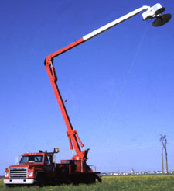
Ground based Platforms
Ground-based sensors are often used to record detailed information about the surface
Compared with information collected from aircraft or satellite sensors
Sensors may be placed on a ladder, scaffolding, tall building, cherry-picker, crane, etc

Slide 11
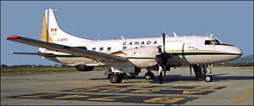
Aerial Platforms
Balloons
Aircraft
Helicopters

Slide 12
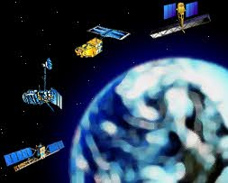
Space Platforms
Space shuttle
Satellites

Slide 13
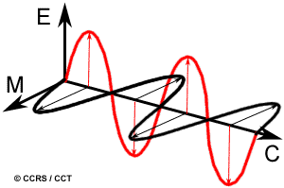
Electromagnetic Radiation
Form of energy that moves with the velocity of light in harmonic pattern consisting of sinusoidal waves
Electric field (E)
Magnetic field (M)

Slide 14
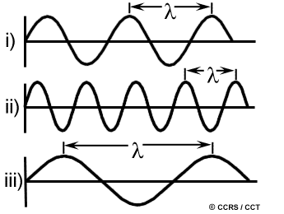
Characteristics of Electro Magnetic Radiation
Wavelength (m)
Frequency (Hz)

Slide 15

Relation between wavelength and frequency

Slide 16
ELECTROMAGNETIC SPECTRUM
EM radiation can be produced at a range of wavelengths and can be categorised according to its position into discrete regions which is referred as electro-magnetic spectrum
Electro-magnetic spectrum is the continuum of energy that ranges from meters to nano meters in wave length

Slide 17
0.4
0.5
0.6
0.7
UV
blue
green
red
Near-IR
Visible
Wavelength (μm)
Wavelength (μm)
(1 mm)
(1 m)
10⁻⁶
10⁻⁵
10⁻⁴
10⁻³
10⁻²
10⁻¹
1
10
10²
10³
10⁴
10⁵
10⁶
10⁷
10⁸
10⁹
10¹⁰
10¹¹
γ Rays
X Rays
Visible
Television
and
Radio
UV Rays
Near-IR
Cosmic Rays
Mid-IR
Microwave
Thermal-IR
The Electromagnetic Spectrum
E
λ = Wavelength
E
Distance
c
M
M
Electromagnetic wave, E-Electrical Component, M-Magnetic Component

Slide 18
Electromagnetic spectrum - wavelength bands
Visible range Blue - 0.4 - 0.5 μm
Green - 0.5 – 0.6 μm
Red - 0.6 – 0.7 μm
Infrared (IR): Near IR - 0.7 – 1.3 μm
Mid IR - 1.3 – 3.0 μm
Thermal IR - beyond 3 μm
Micro wave 1 mm – 1 m
Earth's atmosphere absorbs energy in γ rays, x rays and ultraviolet bands
– not used in Remote Sensing

Slide 19
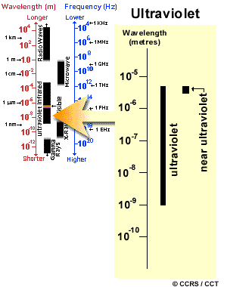
Ultraviolet

Slide 20
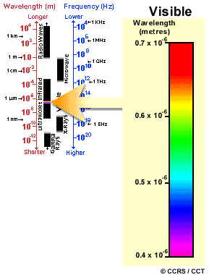
Visible
Violet: 0.4 - 0.446 mm
Blue: 0.446 - 0.500 mm
Green: 0.500 - 0.578 mm
Yellow: 0.578 - 0.592 mm
Orange: 0.592 - 0.620 mm
Red: 0.620 - 0.7 mm

Slide 21
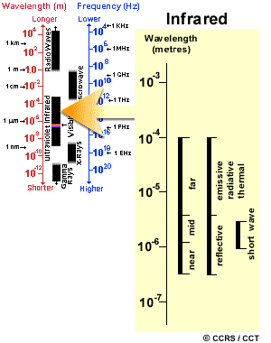
Infrared
0.7 μm to 100 μm
Reflected IR
Thermal IR
Radiation in the reflected IR region is used for remote sensing purposes in ways very similar to radiation in the visible portion. (0.7 μm to 3.0 μm)
The thermal IR region is different than the visible and reflected IR portions, as this energy is essentially the radiation that is emitted from the Earth's surface in the form of heat.
The thermal IR covers 3.0μm to 100 μm

Slide 22
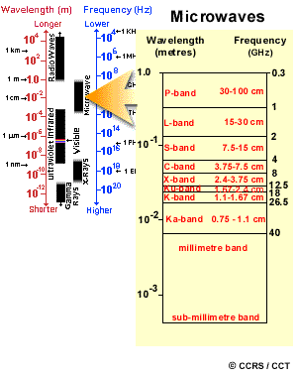
Microwave

Slide 23
Interactions with the Atmosphere
Scattering
Absorption

Slide 24
Scattering
Scattering occurs when particles or large gas molecules present in the atmosphere interact with and cause the electromagnetic radiation to be redirected from its original path
How much scattering takes place depends on several factors including the wavelength of the radiation, the abundance of particles or gases, and the distance the radiation travels through the atmosphere

Slide 25
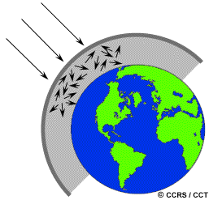
Types of Scattering
Rayleigh scattering
Mie scattering
Nonselective scattering

Slide 26
Rayleigh Scattering
Rayleigh scattering occurs when particles are very small compared to the wavelength of the radiation.
Due to the presence of small dust particles or nitrogen and oxygen molecules.
Causes shorter wavelengths of energy to be scattered much more than longer wavelengths.
Dominant scattering mechanism in the upper atmosphere
The fact that the sky appears "blue" during the day is because of this phenomenon. As sunlight passes through the atmosphere, the shorter wavelengths (i.e. blue) of the visible spectrum are scattered more than the other (longer) visible wavelengths.

Slide 27
Mie Scattering
Mie scattering occurs when the particles are just about the same size as the wavelength of the radiation.
Dust, pollen, smoke and water vapour are common causes of Mie scattering which tends to affect longer wavelengths
Mie scattering occurs mostly in the lower portions of the atmosphere where larger particles are more abundant

Slide 28
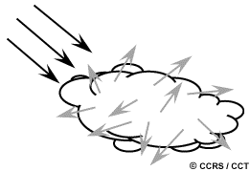
Non selective scattering
Nonselective scattering occurs when the particles are much larger than the wavelength of the radiation.
Water droplets and large dust particles can cause this type of scattering.
Nonselective scattering gets its name from the fact that all wavelengths are scattered about equally.
This type of scattering causes fog and clouds to appear white to our eyes because blue, green, and red light are all scattered in approximately equal quantities (blue+green+redlight= white light)

Slide 29
Absorption
Absorption is the other main mechanism at work when electromagnetic radiation interacts with the atmosphere.
In contrast to scattering, this phenomenon causes molecules in the atmosphere to absorb energy at various wavelengths.
Ozone, carbon dioxide, and water vapour are the three main atmospheric constituents which absorb radiation.
Ozone serves to absorb the harmful (to most living things) ultraviolet radiation from the sun.
Carbon dioxide tends to absorb radiation strongly in the far infrared portion of the spectrum
Water vapour absorbs incoming long wave infrared and shortwave microwave radiation (between 22μm and 1m).

Slide 30
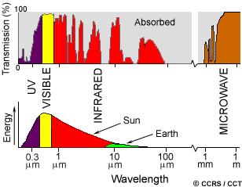
ATMOSPHERIC WINDOWS
Areas of the spectrum which are not severely influenced by atmospheric absorption and thus, are useful to remote sensors, are called atmospheric windows

Slide 31
Spectral bands - Atmospheric windows - Transmission of energy to earth’s surface
0.4 – 0.5 μm Blue
Visible range 0.5 – 0.6 μm Green
0.6 – 0.7 μm Red
Infra Red (IR) 0.7 – 1.3 μm near IR
1.3 – 3 μm mid IR
3.0 – 5 μm
8.0 – 14 μm Thermal IR
Microwave 1mm – 30 cm

Slide 32
INTERACTION OF EMR WITH OBJECT
Reflected depending on nature Incident EMR Absorbed of object & Transmitted wavelength
Emitted
E_{I} (λ) = E_{R} (λ) + E_{A} (λ) + E_{T} (λ)
Remote Sensing Systems operate in the wavelength bands in which reflected energy predominates

Slide 33
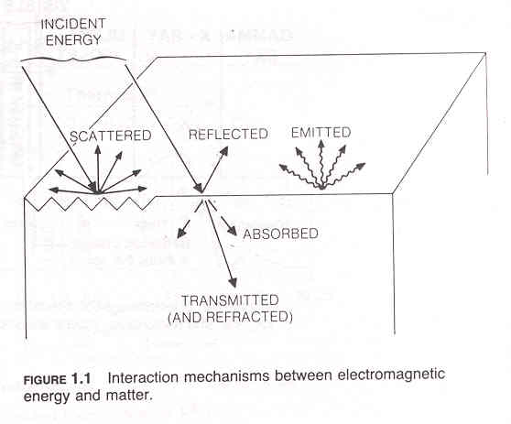

Slide 34
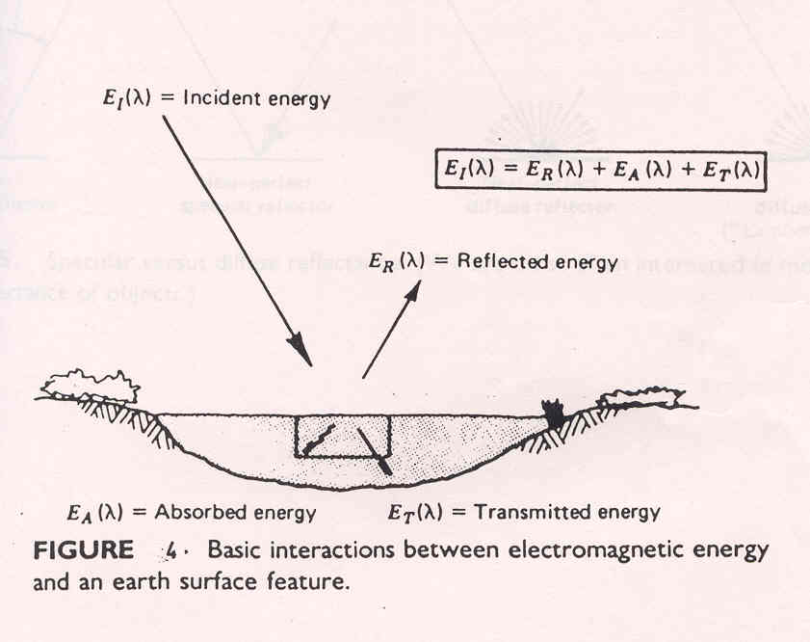
Fig. 4

Slide 35
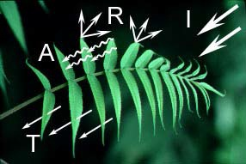
Absorption (A) occurs when radiation (energy) is absorbed into the target while transmission (T) occurs when radiation passes through a target. Reflection (R) occurs when radiation "bounces" off the target and is redirected.
In remote sensing, we are most interested in measuring the radiation reflected from targets.
We refer to two types of reflection specular reflection and diffuse reflection.

Slide 36
When a surface is smooth we get specular or mirror-like reflection where all (or almost all) of the energy is directed away from the surface in a single direction.
Diffuse reflection occurs when the surface is rough and the energy is reflected almost uniformly in all directions.

Slide 37
Nature of Reflection
Depends upon - the angle of incident of EMR
    - surface roughness as a function of wavelength
    - material on either side of the interface
Smooth surface – surface height variations < 8 λ
- Specular (or mirror like) reflection
Rough surface
– surface height variations > 8 λ
    - diffuse reflection – (Lambertian)
    - reflection is scattered and equal in all direction
    - contains information on the colour of reflecting surface
In remote sensing “diffuse reflectance” is measured

Slide 38
CONCEPT OF SIGNATURE
Reflectance characteristics of earth surface features are quantified by measuring the portion of the incident energy that is reflected
Energy of wave length (λ) reflected
Spectral reflectance = x 100
Energy of wave length (λ) incident
The spectral response = spectral signature

Slide 39
A graph of the spectral reflectance of an object as a function of wavelength is called Spectral Reflectance Curve.
Spectral reflectance curves
spectral emittance curves often referred to as ‘Spectral signature’
Spectral reflectance – responsible for colour or tone in visible band

Slide 40
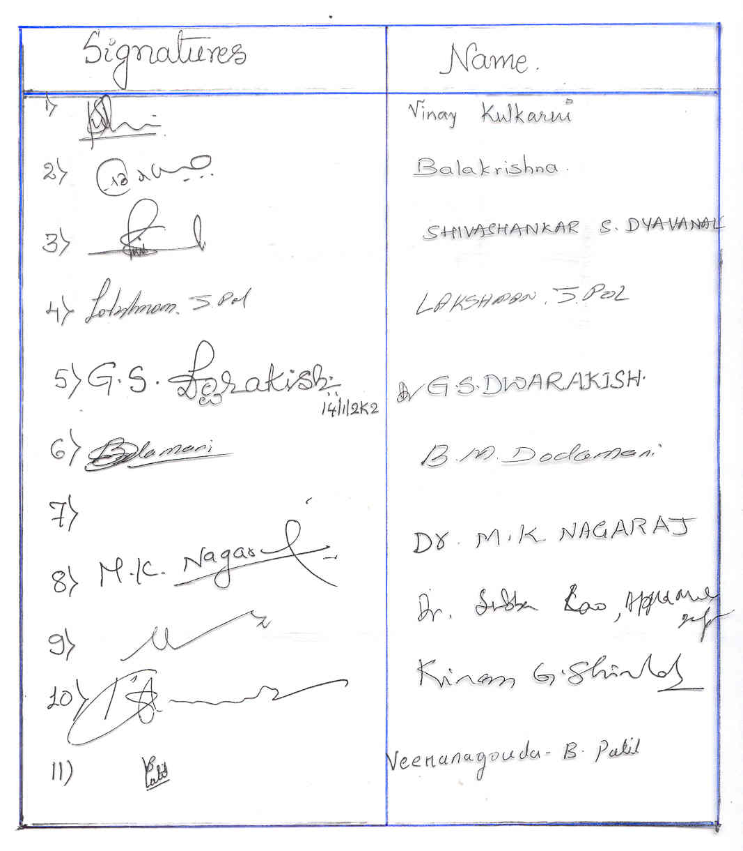

Slide 41
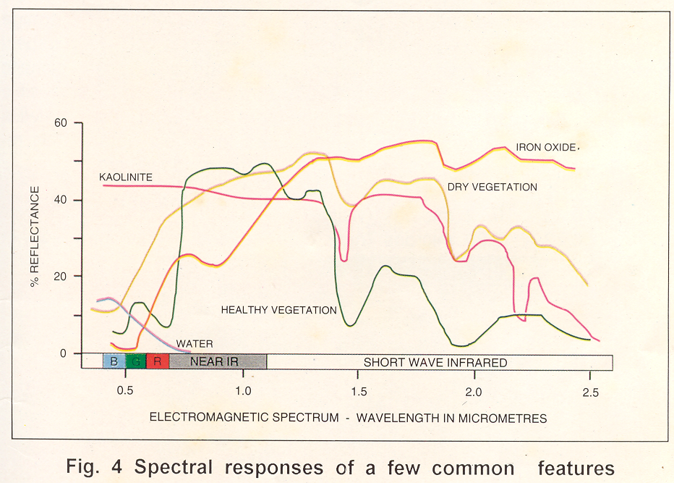

Slide 42
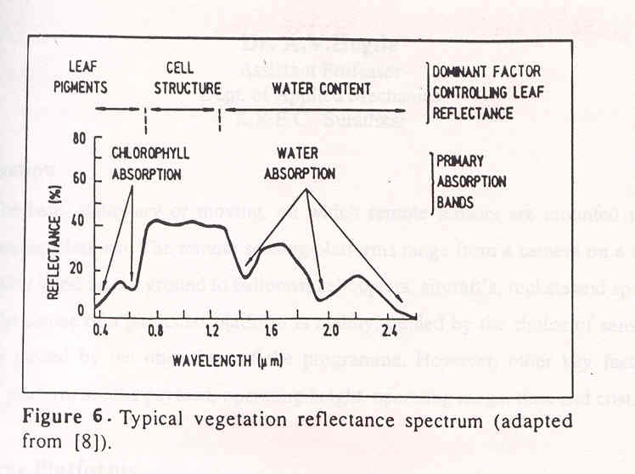
Fig 6

Slide 43
Leaves/vegetation: chlorophyll strongly absorbs radiation in the red and blue wavelengths but reflects green wavelengths.
Leaves appear "greenest“ to us in the summer, when chlorophyll content is at its maximum.
In autumn, there is less chlorophyll in the leaves, so there is less absorption and proportionately more reflection of the red wavelengths, making the leaves appear red or yellow
The internal structure of healthy leaves act as excellent diffuse reflectors of near-infrared wavelengths.
If our eyes were sensitive to near-infrared, trees would appear extremely bright to us at these wavelengths.
In fact, measuring and monitoring the near-IR reflectance is one way that scientists can determine how healthy (or unhealthy) vegetation may be.

Slide 44
Soil
Less peak and valley variations in reflectance
Factors effecting soil reflectance
    - moisture content
    - soil texture (sand, silt and clay)
    - surface roughness
    - presence of iron oxide
    - organic matter content
Water
Little reflectance in only blue and green wave band
Thus water typically looks blue or blue-green due to stronger reflectance at these shorter wavelengths
Presence of turbidity increase the reflectance

Slide 45
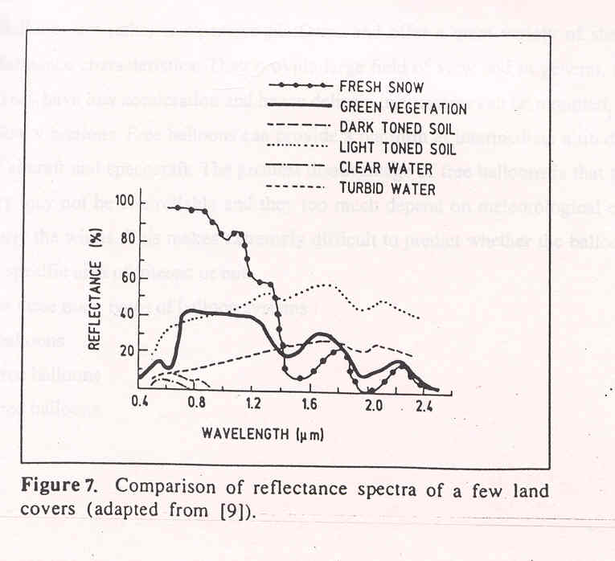
Fig 7

Slide 46
BLACK BODY RADIATION
A black body is a theoretical object that absorbs 100% of the radiation that hits it. Therefore it reflects no radiation and appears perfectly black
In practice no material has been found to absorb all incoming radiation, but carbon in its graphite form absorbs all but about 3%. It is also a perfect emitter of radiation. At a particular temperature the black body would emit the maximum amount of energy possible for that temperature. This value is known as the black body radiation.

Slide 47
CONCEPT OF RESOLUTION
Quality of information derived from RS images strongly influenced by spatial, spectral, radiometric and temporal resolution of the sensor
Spatial Resolution
instrument resolving power needed to spatially discriminate the smallest object
Spectral resolution
encompasses the width of bands used from the wavelengths of the EM spectrum.
Radiometric resolution
quantify No. of discernible signal levels in a band, {sensor’s ability to discriminate radiance differences}
Temporal resolution
time interval between imaging collections over the same geographic location

Slide 48
Spatial Resolution
refers to the size of the smallest possible feature that can be detected.
Spatial resolution of passive sensors depends primarily on their Instantaneous Field of View (IFOV).
The IFOV is the angular cone of visibility of the sensor (A)
Determines the area on the Earth's surface which is "seen" from a given altitude at one particular moment in time (B).
The size of the area viewed is determined by multiplying the IFOV by the distance from the ground to the sensor (C). This area on the ground is called the resolution cell and determines a sensor's maximum spatial resolution.
For a homogeneous feature to be detected, its size generally has to be equal to or larger than the resolution cell. If the feature is smaller than this, it may not be detectable as the average brightness of all features in that resolution cell will be recorded.

Slide 49
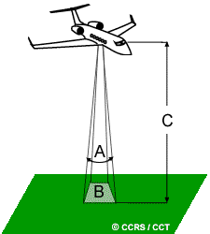
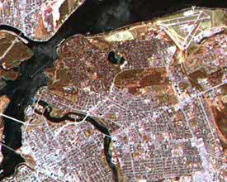
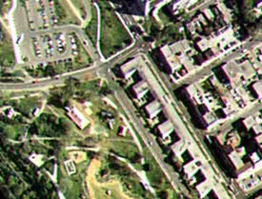
Spatial Resolution

Slide 50
Spectral resolution
Spectral resolution describes the ability of a sensor to define fine wavelength intervals.
The finer the spectral resolution, the narrower the wavelength range for a particular channel or band.
Eg: Spectral resolution of black and white film is fairly coarse, as the various wavelengths of the visible spectrum are not individually distinguished
Colour film has higher spectral resolution, as it is individually sensitive to the reflected energy at the blue, green, and red wavelengths of the spectrum.

Slide 51
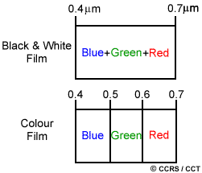
Spectral resolution

Slide 52
Radiometric resolution
sensitivity of the sensor to the magnitude of the electromagnetic energy determines the radiometric resolution.
The radiometric resolution of an imaging system describes its ability to discriminate very slight differences in energy
The finer the radiometric resolution of a sensor, the more sensitive it is to detect small differences in reflected or emitted energy.

Slide 53
Temporal resolution
Refers to revisit period of a satellite sensor
Temporal resolution of a remote sensing system is the time period taken to image the exact same area at the same viewing angle a second time
If the revisit period is less, said to have more temporal resolution

Slide 54
Multispectral scanner (MSS)
A scanning system used to collect data over a variety of different wavelength ranges is called a multispectral scanner (MSS)
Most commonly used scanning system
There are two main modes or methods of scanning employed to acquire multispectral image data - across-track scanning, and along-track scanning.

Slide 55
ACROSS TRACK SCANNERS
Across-track scanners scan the Earth in a series of lines. The lines are oriented perpendicular to the direction of motion of the sensor platform (i.e. across the swath). Each line is scanned from one side of the sensor to the other, using a rotating mirror (A). As the platform moves forward over the Earth, successive scans build up a two-dimensional image of the Earth´s surface. The incoming reflected or emitted radiation is separated into several spectral components that are detected independently. The UV, visible, near-infrared, and thermal radiation are dispersed into their constituent wavelengths. A bank of internal detectors (B), each sensitive to a specific range of wavelengths, detects and measures the energy for each spectral band and they are converted to digital data and recorded for subsequent computer processing.

Slide 56
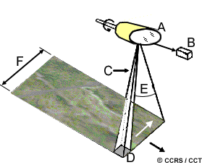

Slide 57
ALONG TRACK SCANNERS
Along-track scanners also use the forward motion of the platform to record successive scan lines Instead of a scanning mirror, they use a linear array of detectors (A) located at the focal plane of the image (B) formed by lens systems (C), which are "pushed" along in the flight track direction (i.e. along track). These systems are also referred to as pushbroom scanners, as the motion of the detector array is analogous to the bristles of a broom being pushed along a floor. Along-track scanners with linear arrays have several advantages over across-track mirror scanners. The array of detectors combined with the pushbroom motion allows each detector to "see" and measure the energy from each ground resolution cell for a longer period of time (dwell time). This allows more energy to be detected and improves the radiometric resolution.

Slide 58
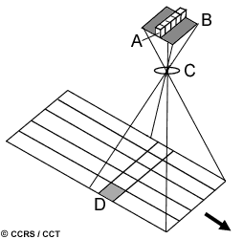

Slide 59
Applications
of
Remote Sensing
(Civil Engg. in Particular)

Slide 60
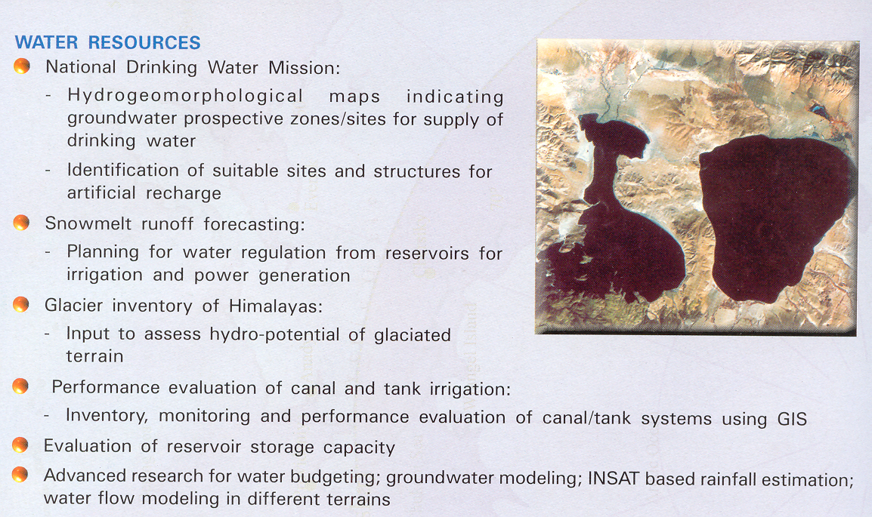

Slide 61
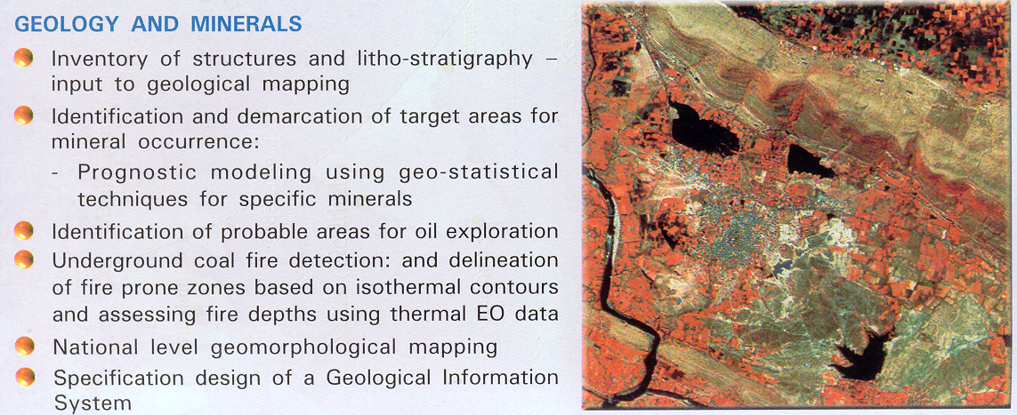

Slide 62
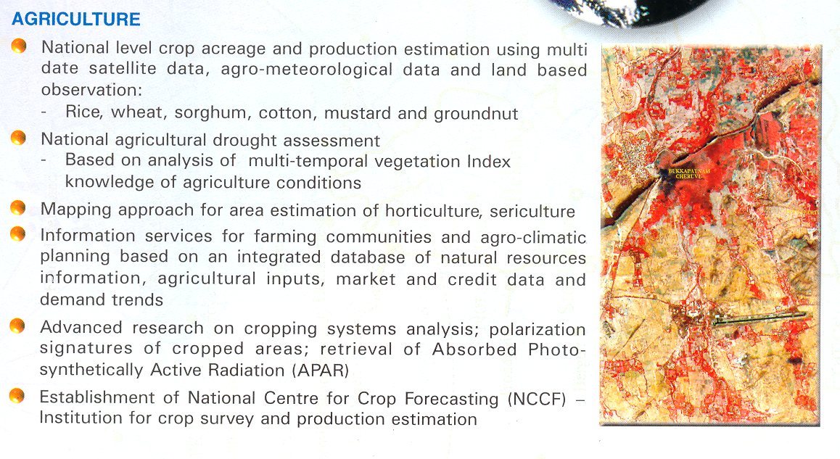

Slide 63
