Slide 1
GEOGRAPHIC INFORMATION SYSTEM
- Is a powerful set of tools for collecting, storing, querying, analyzing and displaying geo spatial data from the real world’
-Burrough (1986)

Slide 2
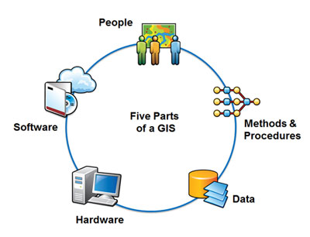
COMPONENTS OF GIS

Slide 3
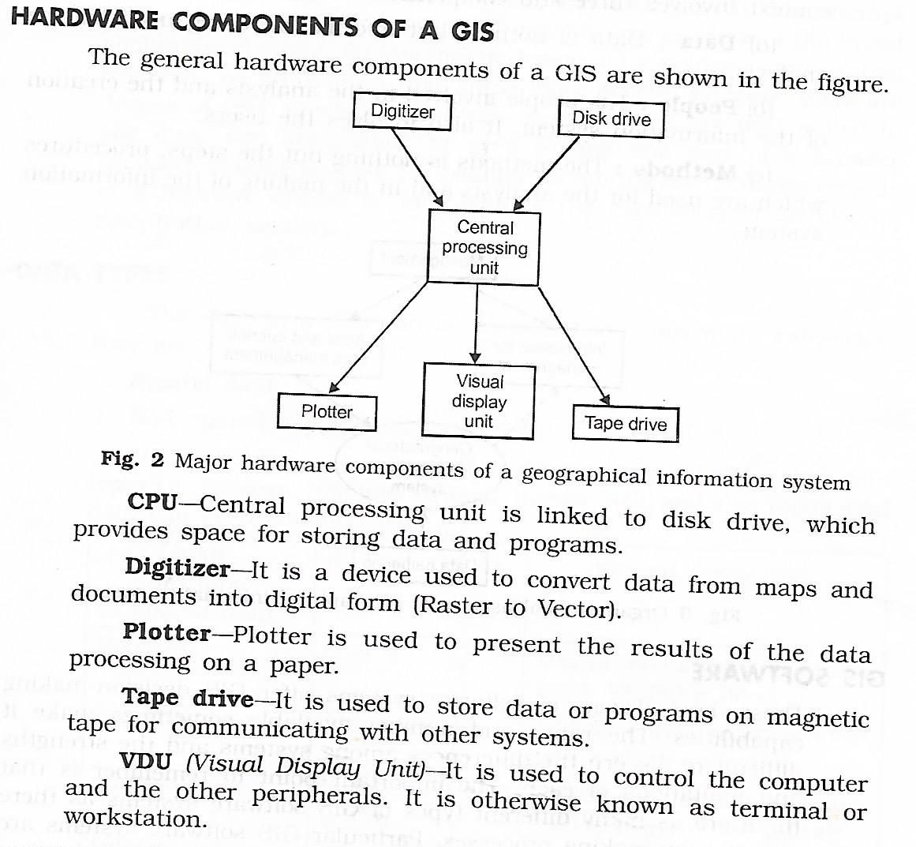
1. HARDWARE

Slide 4
2. SOFTWARE

Slide 5
Commonly used softwares
Autodesk Map
GRASS
Microstation
TransCAD, Maptitude
IDRISI
ArcGIS, ArcView
MGE, GeoMedia
ILWIS
MapInfo

Slide 6
3. DATA
Information being used for the analysis
Geospatial data is the data that describe both the locations and the characteristics of spatial features such as roads, land areas and vegetation
1. Spatial data- represents location
2. Attribute data – represents characteristics

Slide 7
1. Spatial Data
Represents locations of spatial features
Stored in shape file
A. Discrete features – individually distinguishable features that do not exist between observations
Points (eg: Wells)
Lines (eg: roads)
Areas (eg: land use types)
B. Continuous features – features that exist spatially between observations
Eg: Elevation, precipitation

Slide 8
Spatial data
Vector data
uses points and their x,y coordinates to construct spatial features of points, lines and areas
Ideal for representing discrete features
Raster data
uses grid and grid cells to represent the spatial variation of a feature
Better for representing continuous features

Slide 9
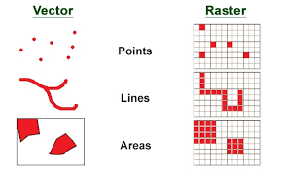
Spatial data

Slide 10
2. Attribute data
Describes characteristics of spatial features
Each cell has a value that corresponds to the attribute of the spatial feature at that location
Eg: a road segment has its attribute length, width, type, speed limit
Stored as database table

Slide 12
4. Methods and Procedures
Steps and procedures used for the analysis and making of the information system
Eg: buffering, overlay, digitisation

Slide 13
5. People
People involved in the analysis and the creation of information system
Also involves users

Slide 15
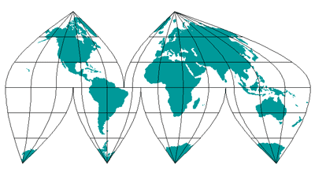

Slide 16
Types of map projections
Based on projection surface
Conic - cone
Cylindrical -cylinder
Azimuthal - plane
Based on line of tangency
Simple – one line of tangency for conic and cylindrical, point of tangency for azimuthal
Secant – two lines of tangency conic and cylindrical, line of tangency for azimuthal
Based on preserved property
Conformal – preserves local angles and shapes
Equivalent – preserves area
Equidistant – maintains consistency of scale
Azimuthal - retains accurate directions

Slide 17
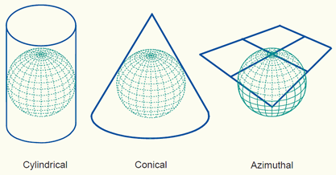
Simple
Projection surface
Reference globe

Slide 18
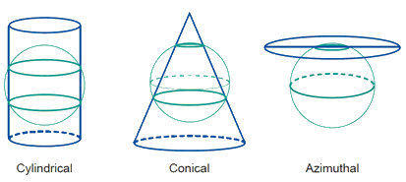
Secant case

Slide 19
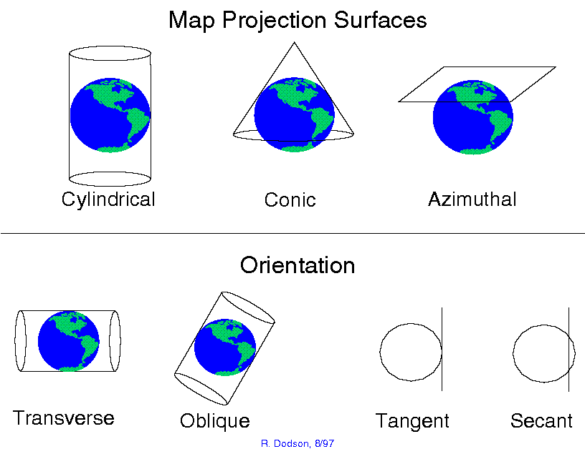
(Aspect)

Slide 20
Map Projection Parameters
Standard line – line of tangency between projection surface and reference globe
Standard parallel – parallel to equator
Standard meridian – parallel to meridian
Principal scale – scale of reference globe (ratio of globe’s radius to earth’s radius)
Applies only to standard line
Scale factor – ratio of local scale to principal scale (local scale applies to other parts of map projection)
Central lines – central parallel and meridian
Centre of map projection- map origin
False easting – assigned x-coordinate value
False northing – assigned y-coordinate value

Slide 21
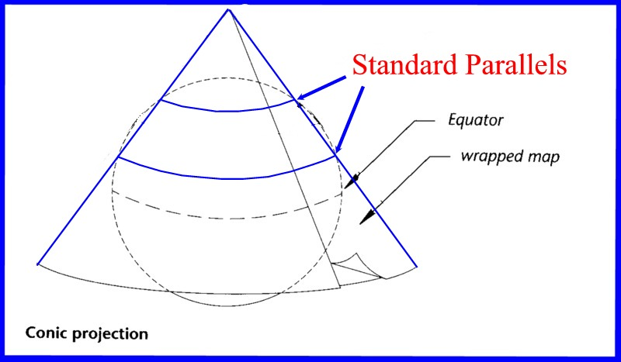
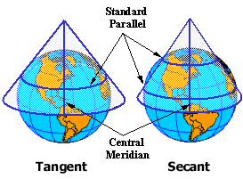

Slide 23
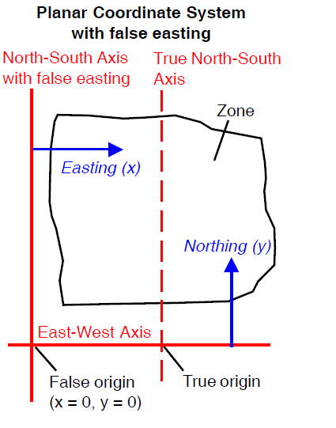

Slide 24
COMMONLY USED MAP PROJECTIONS
MERCATOR
TRANSVERSE MERCATOR
LAMBERT CONFORMAL CONIC
ALBERS EQUAL-AREA CONIC
EQUIDISTANT CONIC

Slide 25
1. MERCATOR PROJECTION
Aid for navigation
The Mercator is a regular cylindrical projection (the cylinder axis passes through the north and south poles).
Meridians of longitude are shown as equally spaced vertical lines, intersected at right angles by straight horizontal parallels.
The spacing between parallels increases away from the Equator to produce a conformal projection.
The scale is true along the equator for a tangent Mercator projection

Slide 26
1. MERCATOR PROJECTION
The poleward increase in spacing of parallels produces great distortions of area in high-latitude regions. In fact, the y coordinate for the poles is infinity
so maps using the Mercator projection rarely extend poleward of 75 degrees latitude.
The Mercator projection remains in common use on nautical charts. Because scale distorion is minor near the equator, it also is a suitable conformal projection for equatorial regions.

Slide 27
2. TRANVERSE MERCATOR PROJECTION
The Transverse Mercator projection is a conformal cylindrical projection with the cylinder rotated 90 degrees with respect to the regular Mercator projection.
The cylinder is tangent to a central meridian of longitude around its entire circumference.
The central meridian and equator are straight lines, but all other meridians and parallels are complex curves.
Scale is constant along any meridian.

Slide 28
2. TRANVERSE MERCATOR PROJECTION
Transverse Mercator projection is useful only for narrow bands along the central meridian
It forms the basis for the Universal Transverse Mercator Coordinate System
In the United States the Transverse Mercator projection is also used in the State Plane Coordinate System for states
Gauss Conformal and Gauss-Kruger are European names for the Transverse Mercator projection

Slide 29
3. LAMBERT CONFORMAL CONIC
constructed with a developable surface that intersects the globe along two standard parallels (SECANT)
Scale is true along the standard parallels, smaller between them, and larger outside them
Area distortion is also relatively small between and near the standard parallels
useful for mid-latitude regions

Slide 30
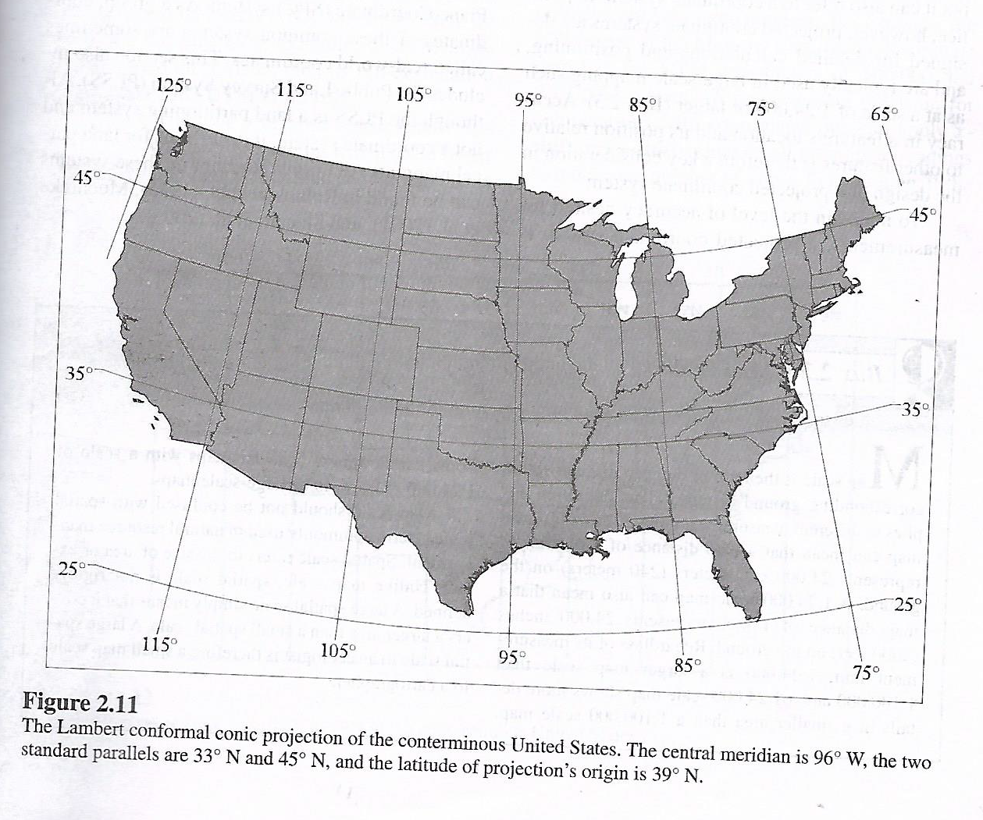

Slide 31
4. ALBERS EQUAL-AREA CONIC
commonly used to map large areas in the mid-latitudes
there are two standard parallels
The parallels are concentric circular arcs with equally-spaced meridians intersecting them at right angles.
The change in spacing between are more widely spaced between the standard parallels, and more closely spaced outside them.
Each parallel has a constant scale, with true scale along the standard parallels, smaller scale between them, and larger scale outside them.
The Albers Conic Equal-Area projection has been used by the U.S. Geological Survey for a number of small-scale maps of the United States, using latitude 29.5º and 45.5º north as standard parallels.

Slide 32
5. EQUIDISTANT CONIC
Also called simple conic projection
Preserves the distance property along all meridians and one or two standard parallels
Uses the same parameters as the Lambert conformal conic

Slide 33
PROJECTED COORDINATE SYSTEMS
UNIVERSAL TRANSVERSE MERCATOR (UTM) GRID SYSTEM
UNIVERSAL POLAR STEREOGRAPHIC GRID SYSTEM (UPS)
STATE PLANE COORDINATE SYSTEM (SPC)

Slide 34
1. UNIVERSAL TRANSVERSE MERCATOR (UTM) GRID SYSTEM
The UTM coordinate system uses the secant case Transverse Mercator map projection, which minimizes shape distortions for small geographic features.
The UTM system divides the world into uniform zones with a width of 6 degrees of longitude.
The zones are numbered from 1 to 60 eastward, with zone 1 beginning at 180 degrees.
Easting is measured from a zone’s central meridian, which is assigned a false easting of 500,000 meters.
Northing values in the southern hemisphere decrease southward from a false northing of 10,000,000 meters at the equator

Slide 35
The scale factor at the central meridian is 0.9996.
The standard meridians are placed 180kms west and east of the central meridian
The designation of UTM zone carries a number and a letter
Eg: UTM Zone 10N refers to the zone between 126⁰W and 120⁰W in the northern hemisphere

Slide 36
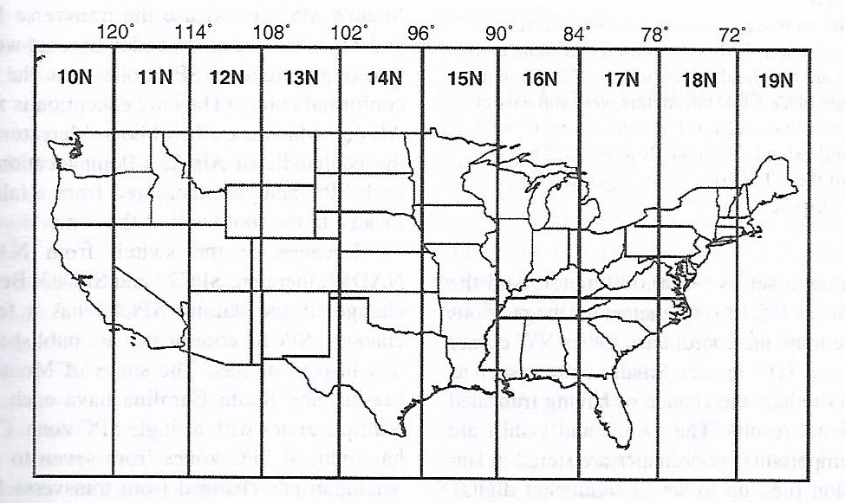

Slide 37
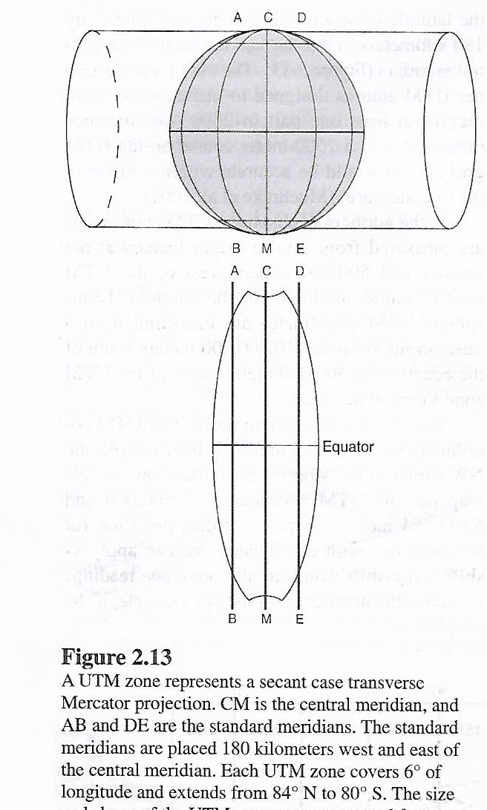

Slide 38
2. UNIVERSAL POLAR STEREOGRAPHIC GRID SYSTEM (UPS)
A conformal azimuthal projection, covers the polar areas
Centered on the pole and used for dividing the polar area into a series of 100000 meter squares
The UPS system is similar to the UTM system, extending this universal system to polar regions.
In this form, the map shows meridians as straight radii of concentric circles representing parallels.

Slide 39
3.STATE PLANE COORDINATE SYSTEM(SPC)
widely used as a grid system for land surveys.
Uses coordinates in feet.
Most states are divided into two or more overlapping state plane zones, each with its own coordinate system and projection.
A few smaller states use a single zone.
The Lambert Conformal Conic projection is used for zones with a larger east-west than north-south extent.
Zones that are more elongated in the north-south direction are mapped using the Transverse Mercator projection.
Scale variations are minimized to provide an accuracy of one part in 10,000 for distance measurements. State Plane Coordinate tick marks and zone
information can be found on U.S. Geological Survey topographic maps.
With the development of the North American Datum 1983, a revised version of
the State Plane Coordinate System based on that datum was also developed. Zones
were redefined for some states, and northing and easting coordinates are nominally
in meters. However, some state and local governments require the use of
feet as a measurement unit with SPCS83. To cover these variations, the TNT
products provide two versions of each SPCS27 and SPCS83 zone, one in meters

Slide 40
THEMATIC OVERLAY
1. TOPOGRAPHY
2. BOUNDARIES
3. VEGETATION
4. ROADS
5. RIVERS
6. SOILS

Slide 41
Advantages of GIS
Establishes interface between spatial data (RS, toposheets, census, surveys, direct measurements, etc) and distributed modeling
Potential for handling large amounts of spatial data using suitable processing software
Data analysis (pre- and post- processing)
Visualization, Preparation of data
Analysis – Interpolation, spatial analysis, query, etc
Hydrological models can run within GIS
Effective communication of results

Slide 42
Urban RS & GIS Applications
Pavement management
Street network facilities
GIS based code enforcement system for land development & Control
Infrastructure management
Living master plan: Integrating infrastructure models
GIS & parcel map automation for assessors
Land use activity model-Policy forecasts & analysis
Transport planning
GIS based planning for School districts, Solid waste landfill site selection
Estimate – impact of airport noise level on residential property values

